Slide 1
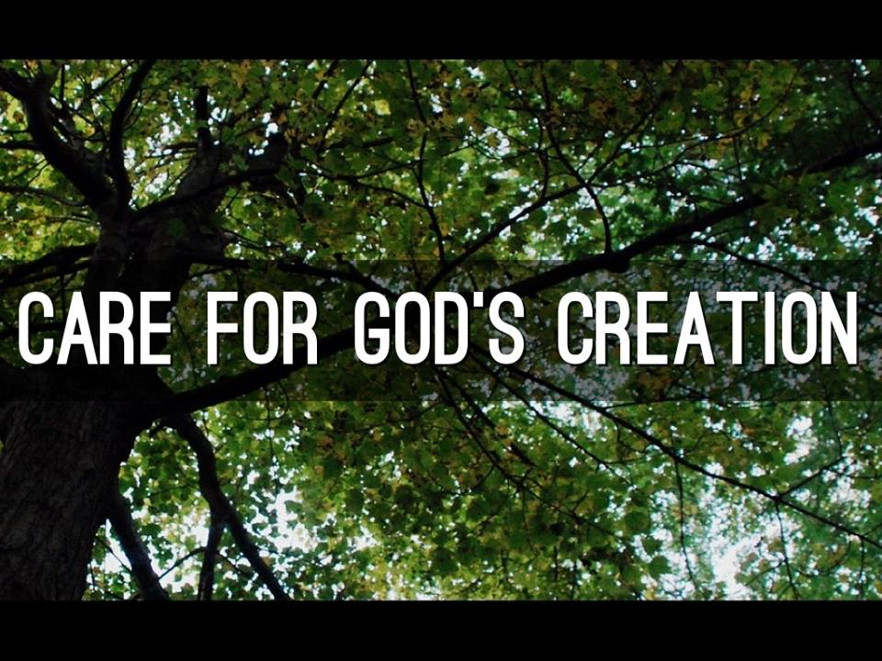

Slide 2
Baptismal Vow
Will you strive to safeguard the integrity of God’s creation and respect, sustain, and renew the life of the earth? People I will, with God’s help.
Why and how?

Slide 3
Genesis 1
1In the beginning when God created* the heavens and the earth, ²the earth was a formless void and darkness covered the face of the deep, while a wind from God* swept over the face of the waters. ³Then God said, ‘Let there be light’; and there was light. ⁴And God saw that the light was good; and God separated the light from the darkness. ⁵God called the light Day, and the darkness he called Night. And there was evening and there was morning, the first day.

Slide 4
6 And God said, ‘Let there be a dome in the midst of the waters, and let it separate the waters from the waters.’ ⁷So God made the dome and separated the waters that were under the dome from the waters that were above the dome. And it was so. ⁸God called the dome Sky. And there was evening and there was morning, the second day. 9 And God said, ‘Let the waters under the sky be gathered together into one place, and let the dry land appear.’ And it was so.

Slide 5
Reader: The earth is the Lord's and the fullness thereof, the world and all that dwells therein. All: We live in God's world, we are not alone. We share this life with the heavens and the earth, with the waters and the land, with trees and grasses, with fish, birds, and animals, with creatures of every form, and with all our brothers and sisters.

Slide 6
Leader: God saw all that was made, and behold, it was very good. Whose World Is It? All: The world and all that is in it belong to our Creator; The earth and all who live in it are God's. Leader: Let us worship our God who calls us to cherish God's creation, so that the web of life which sustains us all may flourish and praise our Creator.

Slide 7
Green Anglicans
Prayer

Slide 8
How environmentally friendly is your house?
Living Ecological Justice pg. 48

Slide 9
What is the Environment Network?
- an opportunity for Anglicans in our diocese (and others) who, as part of their faith, are interested in conservation of the natural environment.

Slide 10
The ministry of the environment network:
- our diocese’s response to fulfilling the fifth Mark of Mission: to “safeguard the integrity of creation and sustain and renew the life of the earth.” - a response to the baptismal covenant: Will you strive to safeguard the integrity of God’s creation and respect, sustain, and renew the life of the earth? - a response to your concern at the Synod of 2011 about the environment

Slide 11
How?
- sustainable agriculture practices, e.g. organic farming, gardening and buying local - threats to the environment like fracking, storage of natural gas, mining, spraying chemicals on our forests - divestment of fossil fuels and renewable energy - practicing the 3Rs, reduce, reuse and recycle - reducing energy use and cost in church buildings

Slide 12
What is the Environment Network?
- an opportunity for Anglicans in our diocese (and others) who, as part of their faith, are interested in conservation of the natural environment.
- our diocese’s response to fulfilling the fifth Mark of Mission: to “safeguard the integrity of creation and sustain and renew the life of the earth.” - a response to the baptismal covenant: Will you strive to safeguard the integrity of God’s creation and respect, sustain, and renew the life of the earth? - a response to our concern at the Synod of 2011 about the environment

Slide 13
What does the network do?
- connect, support and encourage Anglicans who want to actively engage in caring about God’s creation - share information and resources - support people as they take action on environmental issues important to them - connect us with Anglicans and others who are interested or passionate about a healthy environment

Slide 14
o Anglican Communion Environment Network (AKA Green Anglicans) o Creation Matters of the Anglican Church of Canada o PWRDF o Kairos o Greening Sacred Spaces
Ecology Action Centre
Nova Scotia Environmental Network
And others

Slide 15
What does joining the network involve? - A desire to reduce our carbon footprint. (BTW: the distance people have to travel, most of our work is done through the internet or by phone.) - Gathering at opportune times, like Synod. Anyone and everyone is welcome to gather tomorrow at lunch time here under the stage.

Slide 16
Who can get involved? - Anyone who is interested. - Because it is a network rather than a committee, there is no limitation on numbers. - Feel free to have as many people in your parish as you like involved.

Slide 17
Environmental issues and the Anglican Communion
https://www.youtube.com/watch?v=aL7CXi9VjhA

Slide 18
Baptismal Vow
Will you strive to safeguard the integrity of God’s creation and respect, sustain, and renew the life of the earth? People I will, with God’s help.

Slide 19
Environmental Assessment Scavenger Hunt

