Slide 1

Series: Who We Are AND What We Do
Part 2: What We Do
Sunday Sep. 13, 2015

Slide 2
“Where are you in your journey of Christian discipleship?” And, “How might you measure that?”

Slide 3
A disciple of Jesus Christ is someone who learns from Christ to live like Christ.
A disciple of Christ is a worshipper of Christ
A disciple of Christ abides in Christ
A disciple of Christ is a servant like Christ
A disciple of Christ is a disciple-maker for Christ

Slide 4
We believe that a disciple of Jesus Christ says YES to Him when he asks, “Will you follow me?”

Slide 5
We believe that a disciple of Jesus Christ is someone who is willing to take the next step with Jesus Christ.

Slide 6
We believe that discipleship is about turning our will and our lives over to the care of God – giving Him control of our lives, letting Him save us from our sins and from ourselves.

Slide 7
We believe that discipleship is both content and process – that we need to be grounded in the fundamentals of Christian faith and that we need to be in relationship with others to be challenged and encouraged in our everyday lives.

Slide 8
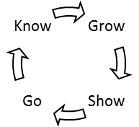

Slide 9
Where are you in the loop?

