Slide 1
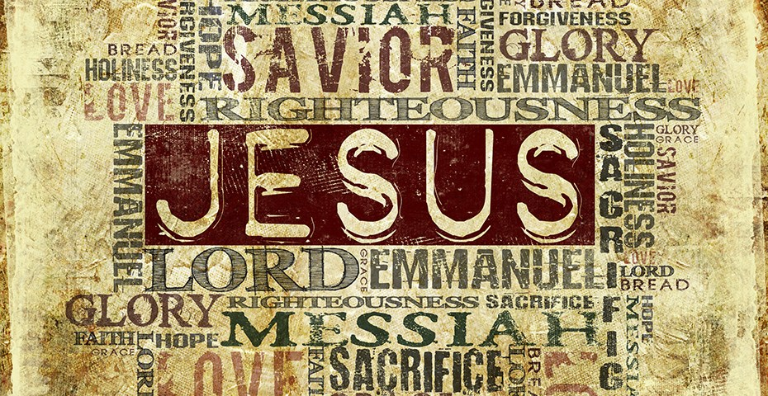
Series: Remembering the Familiar (Popular Passages in the Bible) Part Four: The Lord’s Prayer
Sunday August 27, 2017
Series: Remembering the Familiar (Popular Passages in the Bible)
Part Four: The Lord’s Prayer
Sunday August 27, 2017

Slide 2
1. “This, then, is how you should pray: “Our Father in heaven, hallowed be your name, your kingdom come, your will be done on earth as it is in heaven. Give us today our daily bread. Forgive us our debts, as we also have forgiven our debtors. And lead us not into temptation but deliver us from the evil one” (Mt. 6:6-13).
Series: Remembering the Familiar (Popular Passages in the Bible)
Part Four: The Lord’s Prayer
Sunday August 27, 2017

Slide 3
2. Jesus didn’t say, “This, then, is what you should pray.”
Series: Remembering the Familiar (Popular Passages in the Bible)
Part Four: The Lord’s Prayer
Sunday August 27, 2017

Slide 4
3. What effect might this understanding of God as transcendent Papa have on how we pray? How do we hold these things in tension when we pray? How do we approach a God who is at once familial and comfortable and yet at the same time – set apart and mysterious?
Series: Remembering the Familiar (Popular Passages in the Bible)
Part Four: The Lord’s Prayer
Sunday August 27, 2017

Slide 5
4. You may say to yourself, “My power and the strength of my hands have produced this wealth for me.” But remember the Lord your God, for it is he who gives you the ability to produce wealth … (Deut. 8:17-18).
Series: Remembering the Familiar (Popular Passages in the Bible)
Part Four: The Lord’s Prayer
Sunday August 27, 2017

Slide 6
5. For who makes you different from anyone else? What do you have that you did not receive? And if you did receive it, why do you boast as though you did not? (1 Cor. 4:7).
Series: Remembering the Familiar (Popular Passages in the Bible)
Part Four: The Lord’s Prayer
Sunday August 27, 2017

Slide 7
6. Every good and perfect gift is from above, coming down from the Father of heavenly lights, who does not change like shifting shadows (Jas. 1:17).
Series: Remembering the Familiar (Popular Passages in the Bible)
Part Four: The Lord’s Prayer
Sunday August 27, 2017

Slide 8
7. When tempted, no one should say, “God is tempting me.” For God cannot be tempted by evil, nor does he tempt anyone … (Jas. 1:13).
Series: Remembering the Familiar (Popular Passages in the Bible)
Part Four: The Lord’s Prayer
Sunday August 27, 2017

Slide 9
8. No temptation has seized you except what is common to man. And God is faithful; he will not let you be tempted beyond what you can bear. But when you are tempted, he will also provide a way out so that you can stand up under it 1 Cor. 10:13).
Series: Remembering the Familiar (Popular Passages in the Bible)
Part Four: The Lord’s Prayer
Sunday August 27, 2017

Slide 10
9. Here’s the pattern:
1. Giving praise to God.
Series: Remembering the Familiar (Popular Passages in the Bible)
Part Four: The Lord’s Prayer
Sunday August 27, 2017
2. Praying for His work to be done.
3. Praying for our daily needs and help in our daily struggles.

Slide 11
10. “Our Father in heaven, hallowed be your name, your kingdom come, your will be done on earth as it is in heaven. Give us today our daily bread. Forgive us our debts, as we also have forgiven our debtors. And lead us not into temptation but deliver us from the evil one” (Mt. 6:9-13).
Series: Remembering the Familiar (Popular Passages in the Bible)
Part Four: The Lord’s Prayer
Sunday August 27, 2017

