Slide 1
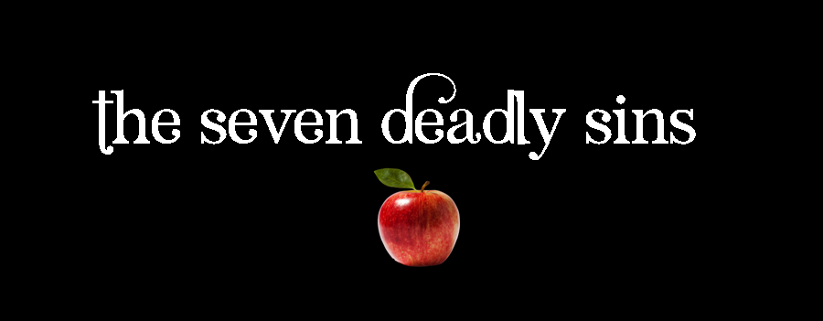
3. GLUTTONY
1 Corinthians 10:23-33
p. 1059

Slide 2
A Week of Tragedy
Ethiopian airlines crash – 157 killed
New Zealand Mosque attack – 50 dead
  Mass murderers – embody themes of culture
Sin is not taken seriously. It should be

Slide 3
Obesity
Public Health Agency, Canada:
  Overweight/Obese: 49% (1978), 64% (2017)
Gluttony is not a simple as being fat – not cured by being slim
It is about disordered consumption

Slide 4
1. Was Jesus a Glutton?
He was accused of it (Luke 7:34)
  Told parables about feasts and banquets.
  Bible puts positive spin on eating (Eccl 5:18, 9:7)
Wonder how Gluttony became a deadly sin?
  Besides Proverbs (e.g. 23:21, 28:7) not much said
God is generous
  Jesus spent much time at meals (Luke 15:2)

Slide 5
1. Was Jesus a Glutton? …
Gluttony not as simple as obesity.
  Thin people can have excessive emphasis on food
  Genetic & socio-economic elements
  Eating disorders destroy lives
  E.g. C S Lewis, “Screwtape Letters”

Slide 6
2. Gluttony as Indulgence
Two favourite verses (Rom 16:18, Phil 3:19)
  Emphasis personal indulgence – doing, getting, having what I want
How does gluttony get on the list?
  Sin is a misuse or excessive focus
    LUST – Seeking self-gratification without regard
    GREED – Making God’s provision what we worship

Slide 7
2. Gluttony as Indulgence …
Two favourite verses (Rom 16:18, Phil 3:19)
  Emphasis personal indulgence – doing, getting, having what I want
How does gluttony get on the list?
  Sin is a misuse or excessive focus
    LUST – Seeking self-gratification without regard
    GREED – Making God’s provision what we worship
    GLUTTONY – God’s gift of food dominates us

Slide 8
2. Gluttony as Indulgence …
Physical health is not the sole issue
  $bn. gym, diet, health industries can be unhelpful
Gluttony: disordering of very real human need
  God’s word as food (Matt 4:4)
  Desire for God as thirst (Ps 63:1)
  Try to satisfy hunger for God with food.

Slide 9
3. Gluttony as Disorder
Right eating:
  SELF: health & well-being.
  OTHERS: Eating is social. Not causing stumbling.
  GOD: Not satisfying spiritual hunger with food.
  CREATION: Consider impact on environment
Eating needs to be rightly controlled

Slide 10
– Living it –
SIMPLICITY
  Easy to be distracted. E.g. Water vs luxuries
  Simplicity when alone, luxury with others
  Joyfully eat what others serve us. (not fussy)
GENEROSITY
  Bring out your best for others
  Bring more than you consume.
  Help more than is your share

Slide 11
– Living it –
MODERATION
  Eat to be healthy, energetic and sociable
  Self discipline is a gift of the Spirit (2 Tim 1:7)
  It is part of maturity (Titus 1:8)

