Slide 1
Notes:
Part 1: Intro (15 minutes): “Realizing Jesus”
Epiphany: The revelation of God AND (equally, vitally impt) for what it means for us in relation to God, the revelation of our true humanity.
Epiphany - Reorienting, Realigning - not external revelation from outside but revelation Breaking in, within, inside out. Metanoia, new understanding, renewed minds and beings, Repentant turning, reorienting, in response to what some in our family have seen, touched, heard, and the rest of us have seen through their witness and the experience of the Spirit.
This weekend by the power and grace of God the Spirit, we will see Jesus:
-not only as the unveiling, Self-Revelation of God (most of us have seen him reveal what the Father is really like - we just don’t believe him).
But also see Jesus unveiled in Israel’s story, as the microcosmic human story
To unveil the truly human life lived out of being known and loved by God, of loving God and loving the other, being for God and one another
Most folks around Jesus, for and against him, had no trouble with his humanity (just the quality of it and what he was doing that was causing trouble and would cost him his life as a threat to power). They missed the epiphany of his divine reality.
We are in the opposite predicament. We have his divinity locked in!
It’s his humanity, and thus who he was and how and why he did what he did with his WHOLE LIFE, that we miss.
We don’t take his humanity, before and after the resurrection, and thus his OWN LIFE IN THE SPIRIT, seriously, so we don’t take our human lives seriously as Spirit-empowered, embodied, forever.
Hence we don’t the plotline of the story we’re in, where it’s headed, what our destiny is, how our present lives participate and enact that destiny even now - we lived misaligned, disoriented, isolated, caught up in a thousand other story lines ready to fill in the gap. (E.G, entitlement, health/bodies, safety, competition, nationalism, consumerism)
Our Christian STORY LINE isn’t much better! WHITEBOARD. Not good news!
NEXT SLIDE (2)

Slide 2
“…conformed to the
image of the Son…
the firstborn of many brothers and sisters.”
St Paul, Rom 8
Notes:
Part 1: Intro (15 minutes): “Realizing Jesus”
Epiphany: The revelation of God AND (equally, vitally impt) for what it means for us in relation to God, the revelation of our true humanity.
Epiphany - Reorienting, Realigning - not external revelation from outside but revelation Breaking in, within, inside out. Metanoia, new understanding, renewed minds and beings, Repentant turning, reorienting, in response to what some in our family have seen, touched, heard, and the rest of us have seen through their witness and the experience of the Spirit.
This weekend by the power and grace of God the Spirit, we will see Jesus:
-not only as the unveiling, Self-Revelation of God (most of us have seen him reveal what the Father is really like - we just don’t believe him).
But also see Jesus unveiled in Israel’s story, as the microcosmic human story
To unveil the truly human life lived out of being known and loved by God, of loving God and loving the other, being for God and one another
Most folks around Jesus, for and against him, had no trouble with his humanity (just the quality of it and what he was doing that was causing trouble and would cost him his life as a threat to power). They missed the epiphany of his divine reality.
We are in the opposite predicament. We have his divinity locked in!
It’s his humanity, and thus who he was and how and why he did what he did with his WHOLE LIFE, that we miss.
We don’t take his humanity, before and after the resurrection, and thus his OWN LIFE IN THE SPIRIT, seriously, so we don’t take our human lives seriously as Spirit-empowered, embodied, forever.
Hence we don’t the plotline of the story we’re in, where it’s headed, what our destiny is, how our present lives participate and enact that destiny even now - we lived misaligned, disoriented, isolated, caught up in a thousand other story lines ready to fill in the gap. (E.G, entitlement, health/bodies, safety, competition, nationalism, consumerism)
Our Christian STORY LINE isn’t much better! WHITEBOARD. Not good news!
NEXT SLIDE (2)

Slide 3
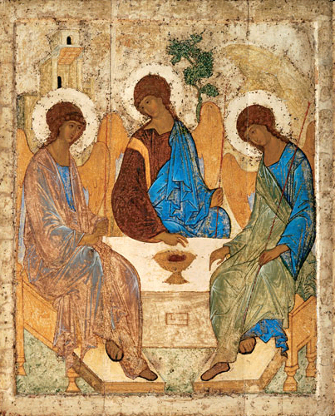
Notes:
Communal Image-bearing

Slide 4
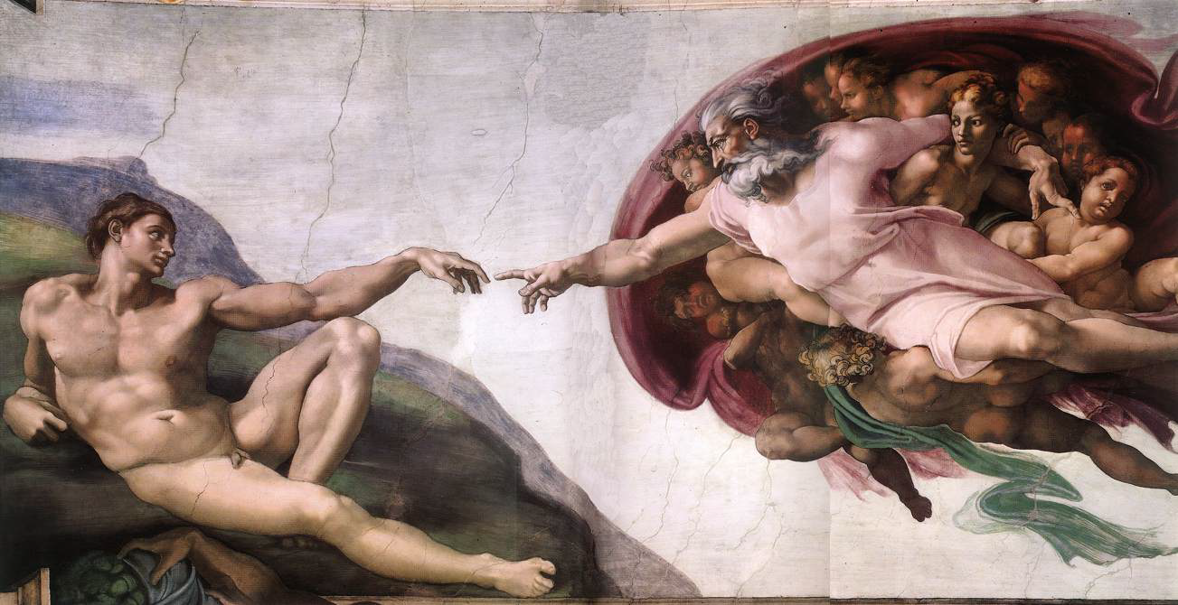
“Let us make human beings in our image, according to our likeness …” (Gen 1:26-27)

Slide 5
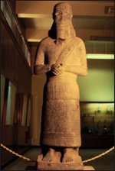
Gen 1:26-7: Ancient Biblical Context
‘image (tslm)’
‘likeness (dmwt)’
= physical, concrete
“ (tslm) … (dmwt) of (king) Hadad-yis‘i’, ruler of Guzan in Syria (9th cent. B.C.)

Slide 6
God’s Embodied Image-Bearers
Image & likeness = Living Human ‘Idols’
(tslm and dmwt)
God’s Children = Royal Representatives
Human made images = false (idolatrous)

Slide 7
“The Son is the radiance of God’s glory
and the exact representation of his being
…made like them, fully human in every way”
Heb 1-2
Notes:
Part 1: Intro (15 minutes): “Realizing Jesus”
Epiphany: The revelation of God AND (equally, vitally impt) for what it means for us in relation to God, the revelation of our true humanity.
Epiphany - Reorienting, Realigning - not external revelation from outside but revelation Breaking in, within, inside out. Metanoia, new understanding, renewed minds and beings, Repentant turning, reorienting, in response to what some in our family have seen, touched, heard, and the rest of us have seen through their witness and the experience of the Spirit.
This weekend by the power and grace of God the Spirit, we will see Jesus:
-not only as the unveiling, Self-Revelation of God (most of us have seen him reveal what the Father is really like - we just don’t believe him).
But also see Jesus unveiled in Israel’s story, as the microcosmic human story
To unveil the truly human life lived out of being known and loved by God, of loving God and loving the other, being for God and one another
Most folks around Jesus, for and against him, had no trouble with his humanity (just the quality of it and what he was doing that was causing trouble and would cost him his life as a threat to power). They missed the epiphany of his divine reality.
We are in the opposite predicament. We have his divinity locked in!
It’s his humanity, and thus who he was and how and why he did what he did with his WHOLE LIFE, that we miss.
We don’t take his humanity, before and after the resurrection, and thus his OWN LIFE IN THE SPIRIT, seriously, so we don’t take our human lives seriously as Spirit-empowered, embodied, forever.
Hence we don’t the plotline of the story we’re in, where it’s headed, what our destiny is, how our present lives participate and enact that destiny even now - we lived misaligned, disoriented, isolated, caught up in a thousand other story lines ready to fill in the gap. (E.G, entitlement, health/bodies, safety, competition, nationalism, consumerism)
Our Christian STORY LINE isn’t much better! WHITEBOARD. Not good news!
NEXT SLIDE (2)

Slide 8
“For the Son of God
became like us
so that we
could become like him.”
- Athanasius
Notes:
Part 1: Intro (15 minutes): “Realizing Jesus”
Epiphany: The revelation of God AND (equally, vitally impt) for what it means for us in relation to God, the revelation of our true humanity.
Epiphany - Reorienting, Realigning - not external revelation from outside but revelation Breaking in, within, inside out. Metanoia, new understanding, renewed minds and beings, Repentant turning, reorienting, in response to what some in our family have seen, touched, heard, and the rest of us have seen through their witness and the experience of the Spirit.
This weekend by the power and grace of God the Spirit, we will see Jesus:
-not only as the unveiling, Self-Revelation of God (most of us have seen him reveal what the Father is really like - we just don’t believe him).
But also see Jesus unveiled in Israel’s story, as the microcosmic human story
To unveil the truly human life lived out of being known and loved by God, of loving God and loving the other, being for God and one another
Most folks around Jesus, for and against him, had no trouble with his humanity (just the quality of it and what he was doing that was causing trouble and would cost him his life as a threat to power). They missed the epiphany of his divine reality.
We are in the opposite predicament. We have his divinity locked in!
It’s his humanity, and thus who he was and how and why he did what he did with his WHOLE LIFE, that we miss.
We don’t take his humanity, before and after the resurrection, and thus his OWN LIFE IN THE SPIRIT, seriously, so we don’t take our human lives seriously as Spirit-empowered, embodied, forever.
Hence we don’t the plotline of the story we’re in, where it’s headed, what our destiny is, how our present lives participate and enact that destiny even now - we lived misaligned, disoriented, isolated, caught up in a thousand other story lines ready to fill in the gap. (E.G, entitlement, health/bodies, safety, competition, nationalism, consumerism)
Our Christian STORY LINE isn’t much better! WHITEBOARD. Not good news!
NEXT SLIDE (2)

Slide 9
“He had to be made like them, fully human in every way,
in order that he might become
a merciful and faithful
high priest in service to God,
and that he might make atonement for the sins of the people.
Because he himself suffered when he was tempted,
he is able to help those who are being tempted.
Therefore, holy brothers and sisters,
who share in the heavenly calling,
fix your thoughts on Jesus,
whom we acknowledge as our apostle and high priest.”
Heb 2-3
Notes:
Part 1: Intro (15 minutes): “Realizing Jesus”
Epiphany: The revelation of God AND (equally, vitally impt) for what it means for us in relation to God, the revelation of our true humanity.
Epiphany - Reorienting, Realigning - not external revelation from outside but revelation Breaking in, within, inside out. Metanoia, new understanding, renewed minds and beings, Repentant turning, reorienting, in response to what some in our family have seen, touched, heard, and the rest of us have seen through their witness and the experience of the Spirit.
This weekend by the power and grace of God the Spirit, we will see Jesus:
-not only as the unveiling, Self-Revelation of God (most of us have seen him reveal what the Father is really like - we just don’t believe him).
But also see Jesus unveiled in Israel’s story, as the microcosmic human story
To unveil the truly human life lived out of being known and loved by God, of loving God and loving the other, being for God and one another
Most folks around Jesus, for and against him, had no trouble with his humanity (just the quality of it and what he was doing that was causing trouble and would cost him his life as a threat to power). They missed the epiphany of his divine reality.
We are in the opposite predicament. We have his divinity locked in!
It’s his humanity, and thus who he was and how and why he did what he did with his WHOLE LIFE, that we miss.
We don’t take his humanity, before and after the resurrection, and thus his OWN LIFE IN THE SPIRIT, seriously, so we don’t take our human lives seriously as Spirit-empowered, embodied, forever.
Hence we don’t the plotline of the story we’re in, where it’s headed, what our destiny is, how our present lives participate and enact that destiny even now - we lived misaligned, disoriented, isolated, caught up in a thousand other story lines ready to fill in the gap. (E.G, entitlement, health/bodies, safety, competition, nationalism, consumerism)
Our Christian STORY LINE isn’t much better! WHITEBOARD. Not good news!
NEXT SLIDE (2)

Slide 10
“In the past God spoke to our ancestors through the prophets
at many times and in various ways,
but in these last days he has spoken to us by his Son,
whom he appointed heir of all things,
and through whom also he made the universe.
The Son is the radiance of God’s glory
and the exact representation of his being,
sustaining all things by his powerful word.
After he had provided purification for sins,
he sat down at the right hand of the Majesty in heaven.”
Heb 1
Notes:
Part 1: Intro (15 minutes): “Realizing Jesus”
Epiphany: The revelation of God AND (equally, vitally impt) for what it means for us in relation to God, the revelation of our true humanity.
Epiphany - Reorienting, Realigning - not external revelation from outside but revelation Breaking in, within, inside out. Metanoia, new understanding, renewed minds and beings, Repentant turning, reorienting, in response to what some in our family have seen, touched, heard, and the rest of us have seen through their witness and the experience of the Spirit.
This weekend by the power and grace of God the Spirit, we will see Jesus:
-not only as the unveiling, Self-Revelation of God (most of us have seen him reveal what the Father is really like - we just don’t believe him).
But also see Jesus unveiled in Israel’s story, as the microcosmic human story
To unveil the truly human life lived out of being known and loved by God, of loving God and loving the other, being for God and one another
Most folks around Jesus, for and against him, had no trouble with his humanity (just the quality of it and what he was doing that was causing trouble and would cost him his life as a threat to power). They missed the epiphany of his divine reality.
We are in the opposite predicament. We have his divinity locked in!
It’s his humanity, and thus who he was and how and why he did what he did with his WHOLE LIFE, that we miss.
We don’t take his humanity, before and after the resurrection, and thus his OWN LIFE IN THE SPIRIT, seriously, so we don’t take our human lives seriously as Spirit-empowered, embodied, forever.
Hence we don’t the plotline of the story we’re in, where it’s headed, what our destiny is, how our present lives participate and enact that destiny even now - we lived misaligned, disoriented, isolated, caught up in a thousand other story lines ready to fill in the gap. (E.G, entitlement, health/bodies, safety, competition, nationalism, consumerism)
Our Christian STORY LINE isn’t much better! WHITEBOARD. Not good news!
NEXT SLIDE (2)

Slide 11
“This salvation, which was first announced by the Lord,
was confirmed to us by those who heard him.
God also testified to it by signs, wonders
and various miracles, and by gifts of the Holy Spirit
distributed according to his will.
It is not to angels that he has subjected the world to come . . .
‘You made [human beings] a little lower than the angels;
you crowned them with glory and honor
and put everything under their feet.’ (Ps 8:5-6)
In putting everything under them,
God left nothing that is not subject to them.”
Heb 2
Notes:
Part 1: Intro (15 minutes): “Realizing Jesus”
Epiphany: The revelation of God AND (equally, vitally impt) for what it means for us in relation to God, the revelation of our true humanity.
Epiphany - Reorienting, Realigning - not external revelation from outside but revelation Breaking in, within, inside out. Metanoia, new understanding, renewed minds and beings, Repentant turning, reorienting, in response to what some in our family have seen, touched, heard, and the rest of us have seen through their witness and the experience of the Spirit.
This weekend by the power and grace of God the Spirit, we will see Jesus:
-not only as the unveiling, Self-Revelation of God (most of us have seen him reveal what the Father is really like - we just don’t believe him).
But also see Jesus unveiled in Israel’s story, as the microcosmic human story
To unveil the truly human life lived out of being known and loved by God, of loving God and loving the other, being for God and one another
Most folks around Jesus, for and against him, had no trouble with his humanity (just the quality of it and what he was doing that was causing trouble and would cost him his life as a threat to power). They missed the epiphany of his divine reality.
We are in the opposite predicament. We have his divinity locked in!
It’s his humanity, and thus who he was and how and why he did what he did with his WHOLE LIFE, that we miss.
We don’t take his humanity, before and after the resurrection, and thus his OWN LIFE IN THE SPIRIT, seriously, so we don’t take our human lives seriously as Spirit-empowered, embodied, forever.
Hence we don’t the plotline of the story we’re in, where it’s headed, what our destiny is, how our present lives participate and enact that destiny even now - we lived misaligned, disoriented, isolated, caught up in a thousand other story lines ready to fill in the gap. (E.G, entitlement, health/bodies, safety, competition, nationalism, consumerism)
Our Christian STORY LINE isn’t much better! WHITEBOARD. Not good news!
NEXT SLIDE (2)

Slide 12
“Yet at present we do not see everything subject to them.
But we do see Jesus,
who was made lower than the angels for a little while,
now crowned with glory and honor
because he suffered death
…in bringing many sons and daughters to glory.
Both the one who makes people holy
and those who are made holy are of the same family.
So Jesus is not ashamed to call them brothers and sisters.”
Heb 2
Notes:
Part 1: Intro (15 minutes): “Realizing Jesus”
Epiphany: The revelation of God AND (equally, vitally impt) for what it means for us in relation to God, the revelation of our true humanity.
Epiphany - Reorienting, Realigning - not external revelation from outside but revelation Breaking in, within, inside out. Metanoia, new understanding, renewed minds and beings, Repentant turning, reorienting, in response to what some in our family have seen, touched, heard, and the rest of us have seen through their witness and the experience of the Spirit.
This weekend by the power and grace of God the Spirit, we will see Jesus:
-not only as the unveiling, Self-Revelation of God (most of us have seen him reveal what the Father is really like - we just don’t believe him).
But also see Jesus unveiled in Israel’s story, as the microcosmic human story
To unveil the truly human life lived out of being known and loved by God, of loving God and loving the other, being for God and one another
Most folks around Jesus, for and against him, had no trouble with his humanity (just the quality of it and what he was doing that was causing trouble and would cost him his life as a threat to power). They missed the epiphany of his divine reality.
We are in the opposite predicament. We have his divinity locked in!
It’s his humanity, and thus who he was and how and why he did what he did with his WHOLE LIFE, that we miss.
We don’t take his humanity, before and after the resurrection, and thus his OWN LIFE IN THE SPIRIT, seriously, so we don’t take our human lives seriously as Spirit-empowered, embodied, forever.
Hence we don’t the plotline of the story we’re in, where it’s headed, what our destiny is, how our present lives participate and enact that destiny even now - we lived misaligned, disoriented, isolated, caught up in a thousand other story lines ready to fill in the gap. (E.G, entitlement, health/bodies, safety, competition, nationalism, consumerism)
Our Christian STORY LINE isn’t much better! WHITEBOARD. Not good news!
NEXT SLIDE (2)

