Slide 1
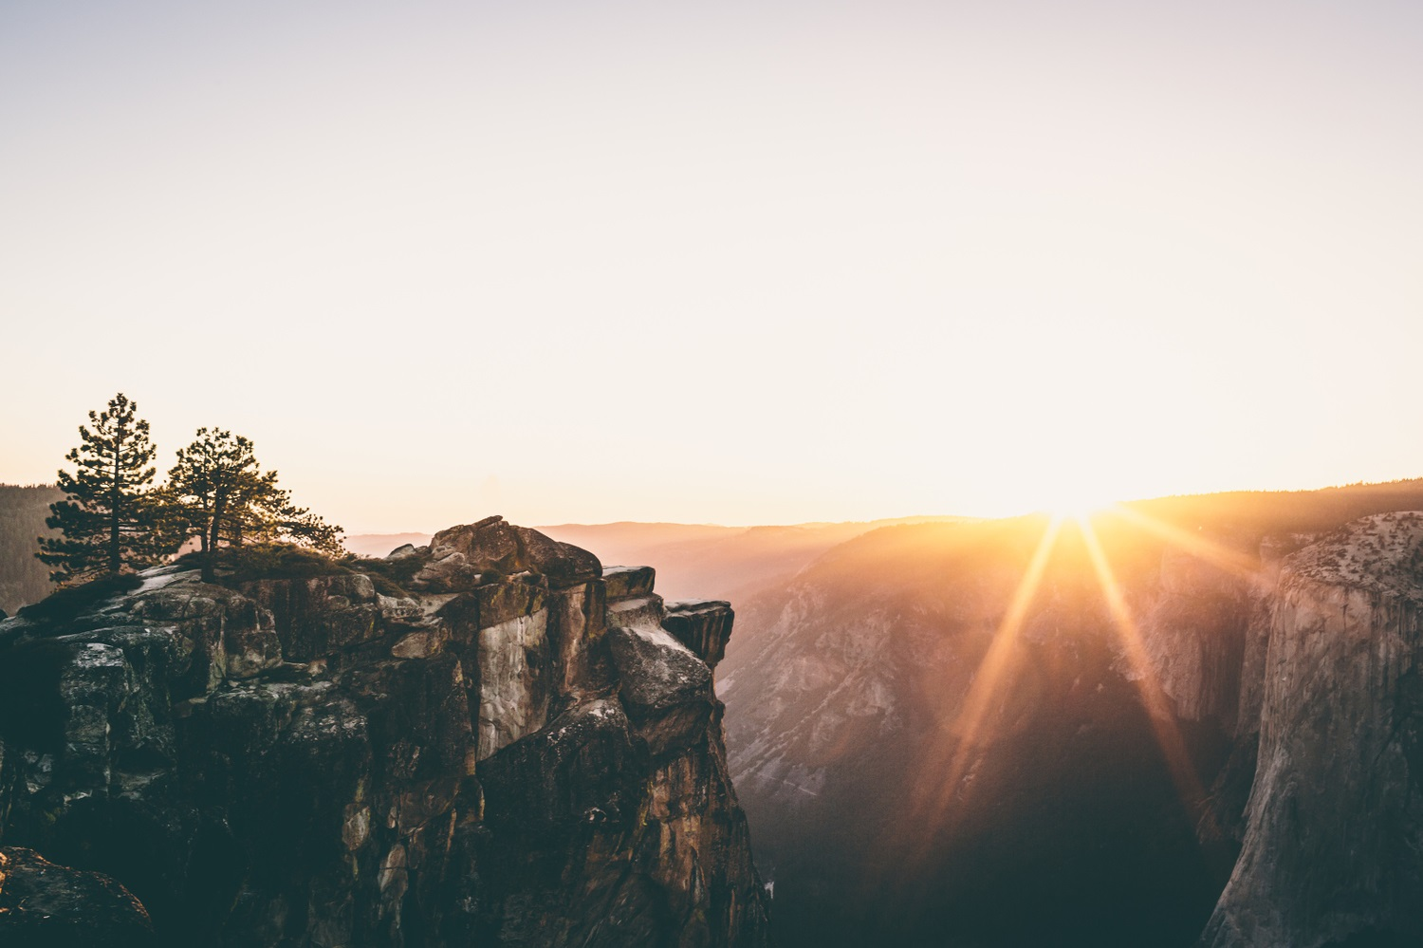
University Chapel
“What is a Human Being?”
Psalm 8
Sunday September 22, 2019

Slide 2
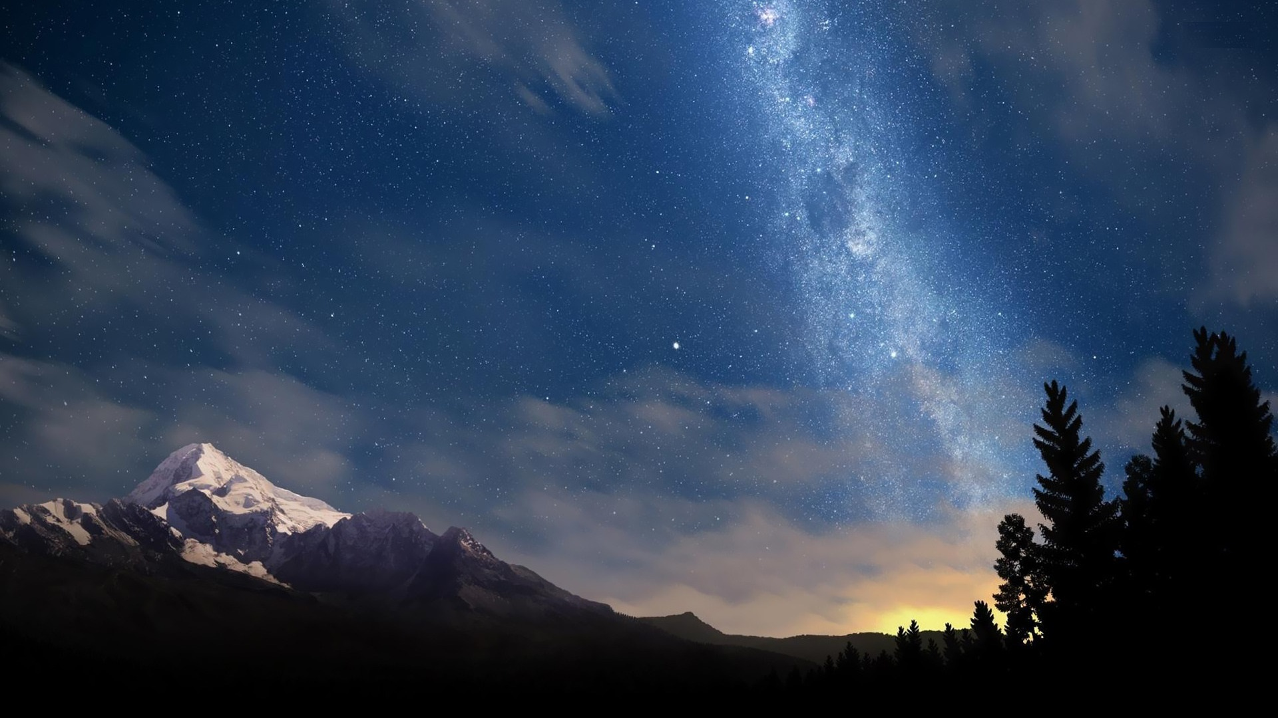
What is a Human Being?
THEORY
OF
K
N
O
W
L
E
D
G
E
EPISTEMOLOGY
Cosmology
(Beliefs about the World)
Theology
(Beliefs about God)
Anthropology
(Beliefs about Humans Beings)

Slide 3
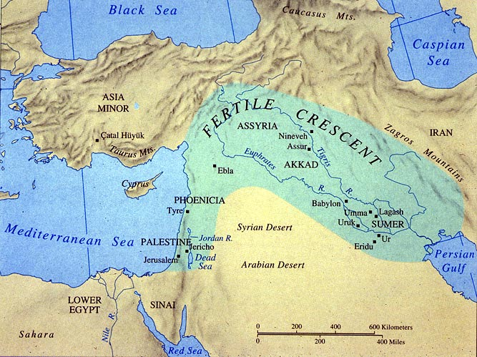
Mesopotamia

Slide 4

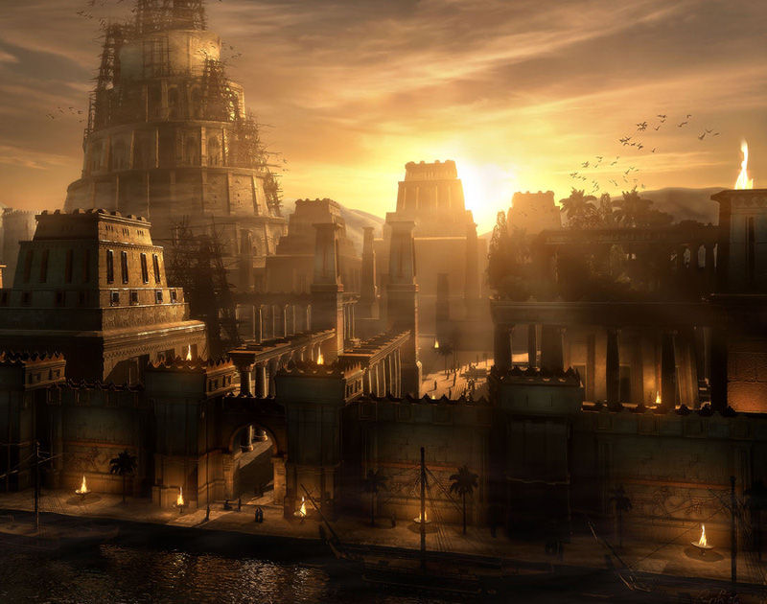
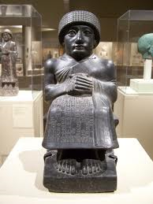
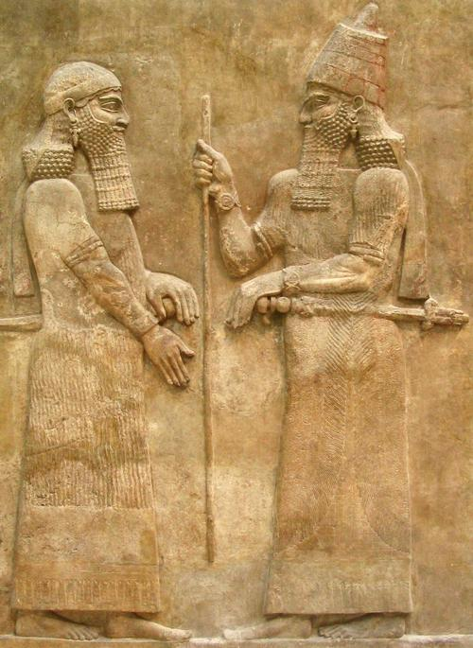
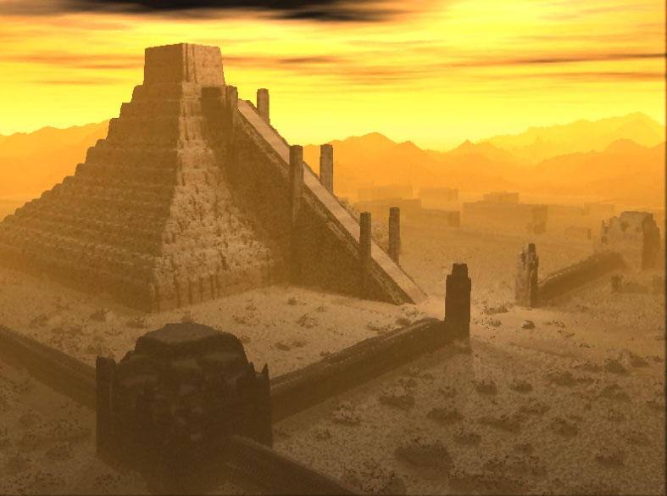

Slide 5
Cosmology
(Beliefs about the World)
THEORY
OF
K
N
O
W
L
E
D
G
E
EPISTEMOLOGY
Theology
(Beliefs about God)
Anthropology
(Beliefs about Humans Beings)
Politics
(Beliefs about the Good Society)

Slide 6
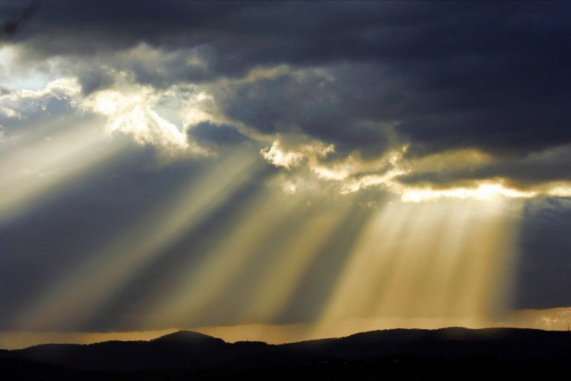
What is a Human Being?
¹ O Lord, our Lord, how majestic is your name in all the earth!
You have set your glory above the heavens.
² From the lips of children and infants you have ordained praise because of your enemies, to silence the foe and the avenger.
³ When I consider your heavens, the work of your fingers, the moon and the stars, which you have set in place,
⁴ what is man that you are mindful of him, the son of man that you care for him?

Slide 7
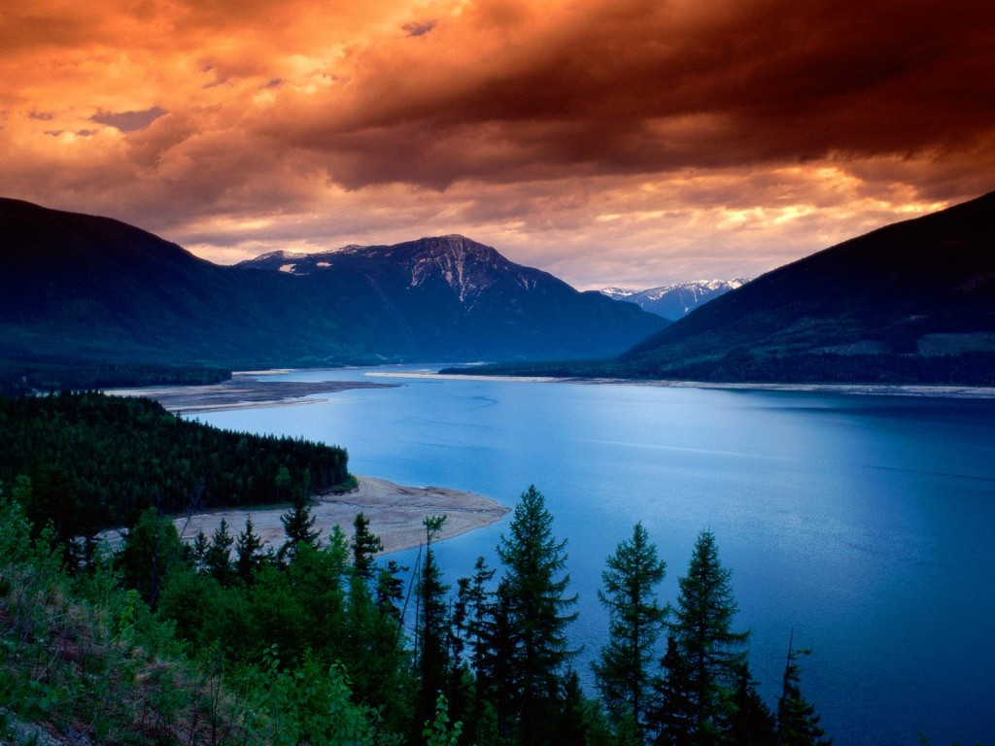
Psalm 8
¹ O Lord, our Lord, how majestic is your name in all the earth!
You have set your glory above the heavens.
² From the lips of children and infants you have ordained praise because of your enemies, to silence the foe and the avenger.
³ When I consider your heavens, the work of your fingers, the moon and the stars, which you have set in place,
⁴ what is man that you are mindful of him, the son of man that you care for him?

Slide 8
Psalm 8
¹ O Lord, our Lord, how majestic is your name in all the earth!
You have set your glory above the heavens.
² From the lips of children and infants you have ordained praise because of your enemies, to silence the foe and the avenger.
³ When I consider your heavens, the work of your fingers, the moon and the stars, which you have set in place,
⁴ what is man that you are mindful of him, the son of man that you care for him?
Nothing

Slide 9
Psalm 8
⁵ You made him a little lower than God, and crowned him with glory and honor.
⁶ You made him ruler over the works of your hands; you put everything under his feet:
⁷ all flocks and herds, and the beasts of the field,
⁸ the birds of the air, and the fish of the sea, all that swim the paths of the seas.
⁹ O Lord, our Lord, how majestic is your name in all the earth!
glory and honor

Slide 10
Psalm 8
⁵ You made him a little lower than God, and crowned him with glory and honor.
⁶ You made him ruler over the works of your hands; you put everything under his feet:
⁷ all flocks and herds, and the beasts of the field,
⁸ the birds of the air, and the fish of the sea, all that swim the paths of the seas.
⁹ O Lord, our Lord, how majestic is your name in all the earth!

Slide 11
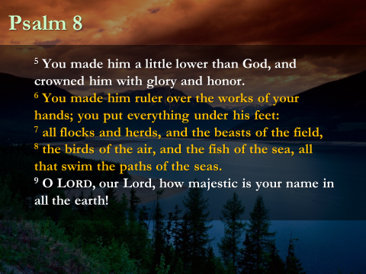
Psalm 8
⁵ You made him a little lower than God, and crowned him with glory and honor.
⁶ You made him ruler over the works of your hands; you put everything under his feet:
⁷ all flocks and herds, and the beasts of the field,
⁸ the birds of the air, and the fish of the sea, all that swim the paths of the seas.
⁹ O Lord, our Lord, how majestic is your name in all the earth!

Slide 12
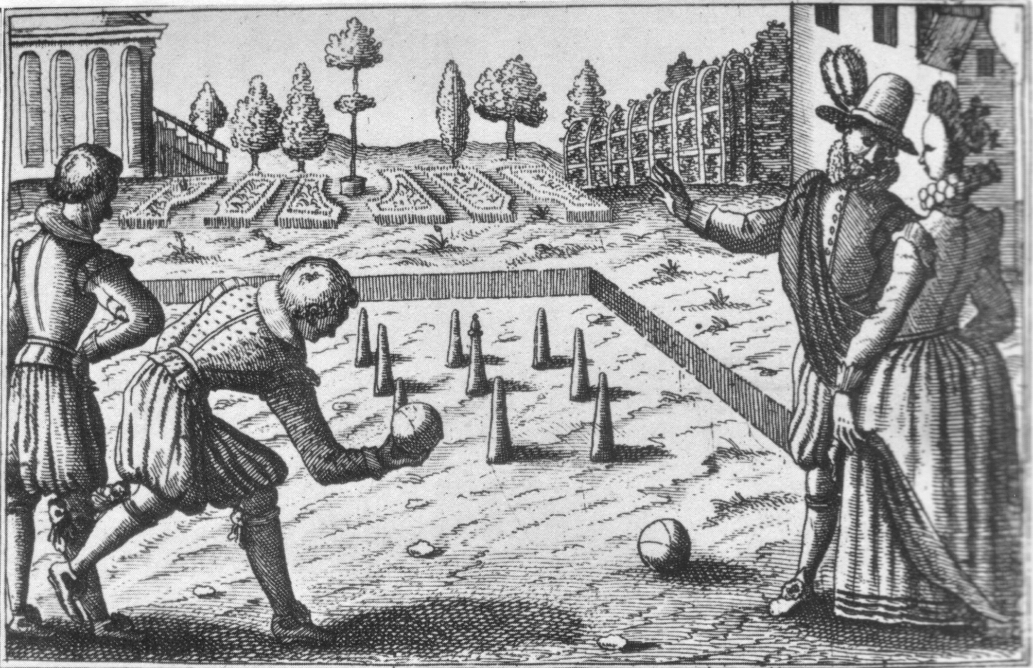
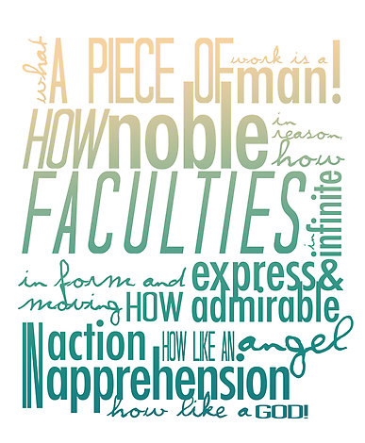
Fearfully and wonderfully made
Crowned with glory and honor

Slide 13
How Does David Know?

Slide 14
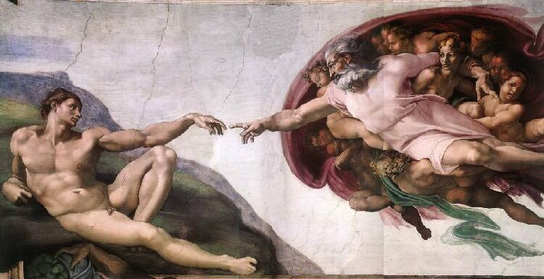

Slide 15
Family / Tribe / State
Non-Human Creation
Inside Myself

Slide 16
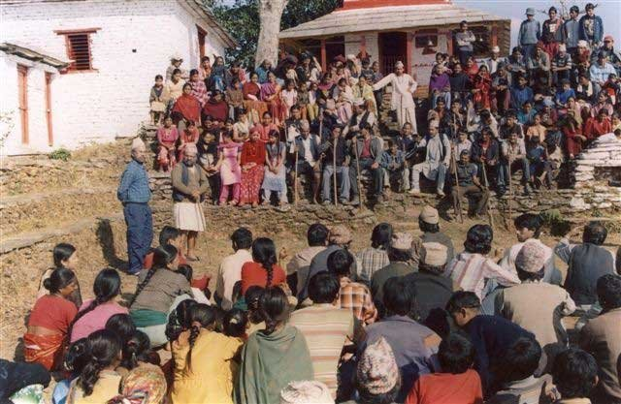
Anthropology
(Beliefs about Humans Beings)
Politics
(Beliefs about the Good Society)
Humanism
Democracy

Slide 17

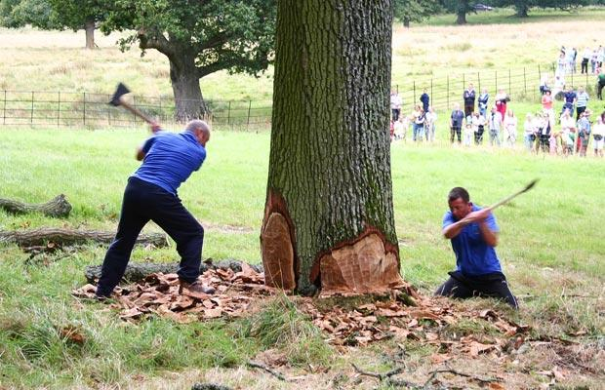
The Tree of Western Culture

Slide 18
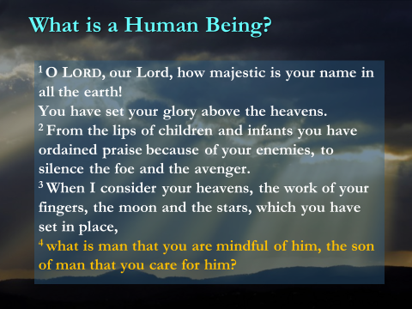
What is a Human Being?
¹ O Lord, our Lord, how majestic is your name in all the earth!
You have set your glory above the heavens.
² From the lips of children and infants you have ordained praise because of your enemies, to silence the foe and the avenger.
³ When I consider your heavens, the work of your fingers, the moon and the stars, which you have set in place,
⁴ what is man that you are mindful of him, the son of man that you care for him?

