Slide 1
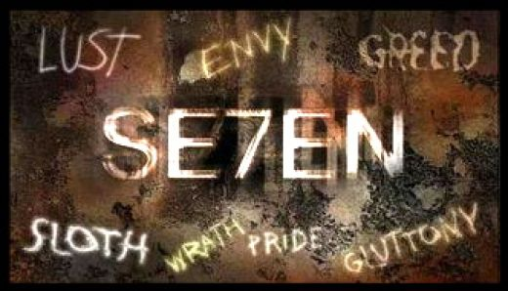
1. Seven Deadly Sins
– LUST –
Matthew 5:27-30
p. 893

Slide 2
Poison
A story told by Billy Graham
  We’ve put a mild label on sin
  Time to put the Label back
New series: the Seven Deadly Sins

Slide 3
Sins & Virtues
New series: the Seven Deadly Sins
Sins | Virtues
Lust | Chastity
Gluttony | Temperance
Greed | Charity
Sloth (Laziness) | Diligence
Wrath (Anger) | Forgiveness
Envy | Kindness
Pride | Humility

Slide 4
1. A Definition
Not normal, healthy sexual desire
Lust is selfish
  Focused on our own gratification & satisfaction
“Do not commit adultery” - 7th commandment
  Not only doing, but thinking

Slide 5
1. A Definition …
Catechism of the Catholic Church (#2351)
  Disordered desire
  Isolated from procreative & unitive purpose
NT – epithumia – desire, longing, craving
  Burning with desire, insatiable craving
  Beyond sexual (Mark 4:19)

Slide 6
1. A Definition …
Rightly ordered sexual desire:
  A Gift for procreation, unity, intimacy
Disordered sexual desire:
  Selfish, without boundaries, personal gratification
Fire under control is good … … out of control is destructive

Slide 7
2. Sexuality is a Big Deal
Two errors:
  Just a basic need
    Like eating & drinking
    No record of dying because of no sex!
  Of little consequence
    Christians make too much of it
    Like a tasteless meal – who cares?

Slide 8
2. Sexuality is a Big Deal …
The lie revealed: Rape & Sexual Abuse
  It is devastating!
  If it’s nothing – why cant rape victims brush it off like food poisoning?
Sexuality is deeply personal (1 Cor. 6:18)
  Like smoking it may seem cool when we’re young
  When time passes it comes home to roost

Slide 9
3. Sexuality & Our Humanity
A powerful expression of intimacy
  Embedded in our humanity – a deep self-giving
We want connection & belonging
  Cannot be fast-tracked, steps cannot be skipped
  Reason is connected to the creation story

Slide 10
3. Sexuality & Our Humanity …
Image of God
  Use another for gratification – objectifying them
  No longer see them as an image bearer of God
  The perspective of our own needs & desires
  Jesus looks at their feelings, needs & desires
    Being a servant to them (Mark 10:43-45)

Slide 11
3. Sexuality & Our Humanity …
One Flesh
  Adam is created sexually undifferentiated
  It is NOT GOOD for man to be alone (Gen 2:18)
  Makes a ‘helper’ from a rib (Woman)
  Become “one flesh” again in marriage (Gen 2:24)
  Once joined again, cannot be divided (Mt 19:6)

Slide 12
3. Sexuality & Our Humanity …
Lust, adultery, sexual license are poisonous
  Without intimacy, keep interesting by perversity
God does not keep sex from us … … He keeps sex for us
Being Single
  Intimacy with God & with friends in community.

Slide 13
– Living it –
A big issue – speak Biblical truth into it
  Many are being hurt
Sex a good gift, mishandled leads to heartache
  Not wrong ourselves or each other (1 Th 4:3-6)
  If you have struggles speak to me or someone
Redemption & forgiveness in Christ (1 Cor 6:9f)

Slide 14
– Living it –
Making some forms of sexual behavior more wrong than others
All sexuality outside of life-long marriage between a man & a woman is a rejection of how we are created, robs us of God’s good intent

