Slide 1
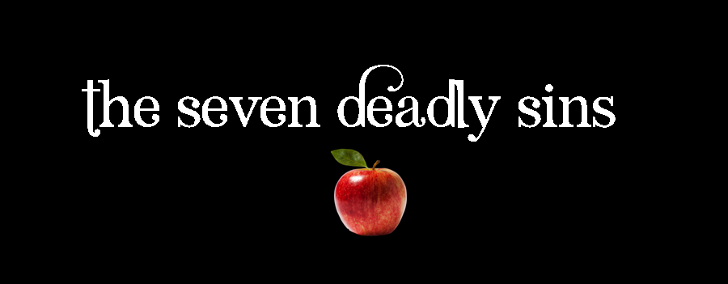
6. Anger
Ephesians 4:25-32
p. 1081

Slide 2
Rage
Road Rage … Air Rage … Desk Rage
  Publicly expressing hostility, rudeness

Slide 3
1. Anger: Two Faces
Anger itself is not sin (Eph 4:26)
Jesus was angry (John 2:14 ff)
  Anger: a response to sin (Rom 1:18, Isa 13:9)
  Not to rage against sin is to lack godly passion
Anger’s two faces:
  In response to sin & injustice – righteous
  Wrong target or out of control - sin

Slide 4
2. Righteous Anger:
Response to Injustice
Righteous anger: response to objective injustice
  Indifference to injustice is a problem
  E.g. Forced removals in South Africa
  Indifference is a lack of love
  Reasoned and controlled anger is almost required
Aquinas: anger motivator for the good fight

Slide 5
3. Sinful Anger: Concern for Self
Most common anger is personal
3 ways anger may be disordered:
  Comes too quickly (quick-tempered, irritable)
  Disproportionate (over-reacting, excessive)
  Lingers (grudge, resentment, passive-aggressive)

Slide 6
3. Sinful Anger: Concern for Self …
Seldom get it right: rarely justified (Jas 1:20)
  Only - anger against our own sin & spiritual forces
  Commonly, keep away from it (Eph 4:31)
Jesus opposed injustice to the poor, needy
  When falsely accused, tried … went meekly

Slide 7
3. Sinful Anger: Concern for Self …
Taught radical disregard for personal injustices (Matt 5:38 ff)
  He did not stand up for his rights – laid them down
  He reacted to injustices done to others
  He called religious leaders “blind guides” (Mt 23:4f)
He never did anything to advantage himself
We should be the same

Slide 8
– Living it –
Anger is a problem
It is an area we can be radically different
  Turn the other cheek, lay aside our rights
Another way to respond – become angry
  This kind of anger is a danger to the soul

Slide 9
– Living it –
Evagrius – “avenging yourself - stumbling block”
Anger distorts reason
  Becomes self-serving advancement of our rights
A regular review of our anger is a helpful part of self awareness

