Slide 1

3. Temperance
The Hidden, Crucial Virtue
1 Timothy 6:3-11, 17-19 (p. 1100)

Slide 2
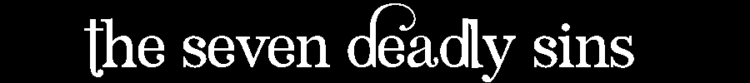
Lust
Greed
Gluttony
Apathy
Envy
Anger
Pride

Slide 3
Chastity
Generosity
Temperance (You are here)
Diligence
Kindness
Patience
Humility

Slide 4
Sin & Virtue
Lust
Greed
Gluttony
Apathy
Envy
Anger
Pride
Chastity
Generosity
Temperance
Diligence
Kindness
Patience
Humility

Slide 5
Why?
Path from slavery to sin to freedom

Slide 6
Sin & Virtue
Lust
Greed
Gluttony
Apathy
Envy
Anger
Pride
Chastity
Generosity
Temperance
Diligence
Kindness
Patience
Humility

Slide 7
Why?
Path from slavery to sin to freedom
Path to relationship and community

Slide 8
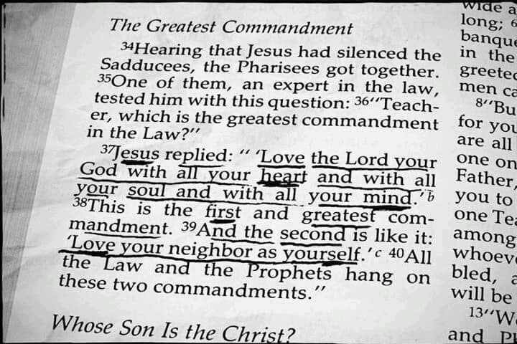

Slide 9
Sin & Virtue
Lust
Greed
Gluttony
Apathy
Envy
Anger
Pride
Chastity
Generosity
Temperance
Diligence
Kindness
Patience
Humility

Slide 10
Why?
Path from slavery to sin to freedom
Path to relationship and community
Path to becoming like Christ, restored to the image of God

Slide 11
Sin & Virtue
Lust
Greed
Gluttony
Apathy
Envy
Anger
Pride
Chastity
Generosity
Temperance
Diligence
Kindness
Patience
Humility

Slide 12
1. Understanding Temperance
“Going the right length”

Slide 13
Understanding Temperance
“Temperance is the moral virtue that moderates the attractions of pleasures and provides balance… it ensures the will’s mastery over instincts and keeps desires within the limits of what is honourable… in the New Testament it is called ‘moderation’ or ‘sobriety’”
- Catechism (Christian Instruction)

Slide 14
Paul’s “No” List
“Unhealthy cravings... which produces envy, dissension... constant friction among people” (6:4)
“...many senseless and harmful desires that plunge people into ruin...” (6:9)
“...through this craving [love of money] some have wandered away from the faith” (6:10)
Etc...

Slide 15
Paul’s “No” List
“Unhealthy cravings... which produces envy, dissension... constant friction among people” (6:4)
“...many senseless and harmful desires that plunge people into ruin...” (6:9)
“...through this craving [love of money] some have wandered away from the faith” (6:10)
Etc...

Slide 16
Paul’s “Yes” List
“but godliness with contentment is great gain” (6:6)
“Flee these things... pursue righteousness, godliness, faith, love, steadfastness, gentleness...” (6:11)
“do good, be rich in good works, be generous... so that they may take hold of that which is truly life” (6:18)
Etc..

Slide 17
Temperance isn’t:
Denial of desire or emotions
Temperance isn’t very noticeable
Lack of temperance is known as gluttony

Slide 18
2. Dangers of Gluttony
“Emphasizes personal indulgence”

Slide 19
Dangers of Gluttony
Emphasizes personal indulgence: doing, getting, having what I want
God’s gift of food dominates us
God’s gift of _____ dominates us

Slide 20
Paul’s “Yes” List
“but godliness with contentment is great gain” (6:6)
“Flee these things... pursue righteousness, godliness, faith, love, steadfastness, gentleness...” (6:11)
“do good, be rich in good works, be generous and ready to share... So that they may take hold of that which is truly life” (6:18)

Slide 21
Temperance
“going the right length”
temparare (Latin) – “to mix together in due proportions”

Slide 22
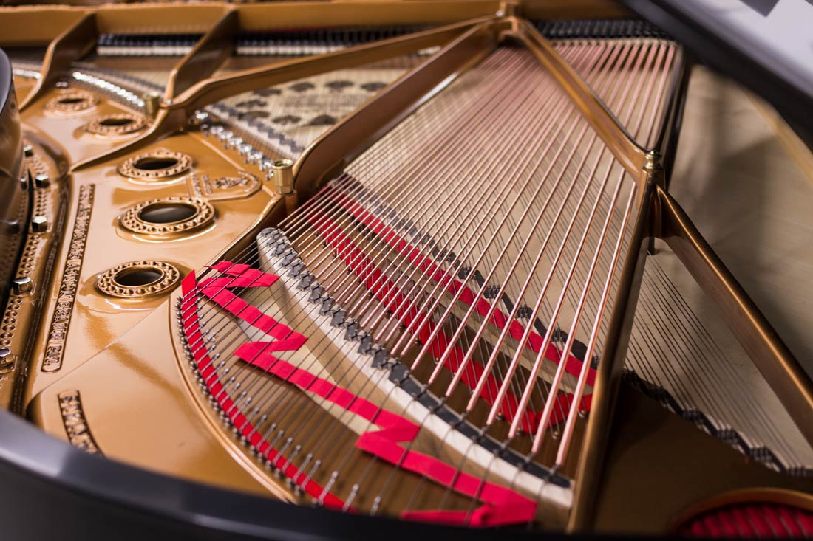

Slide 23
3. Temperance’s Freedom
“Serenity of spirit...”

Slide 24
Temperance’s Freedom
Freed from wild extremes, being enslaved by our passions
Freed to do “do good, be rich in good works… and taking hold of that which is truly life” (6:18-19)

Slide 25
The Temperance of Christ

Slide 26
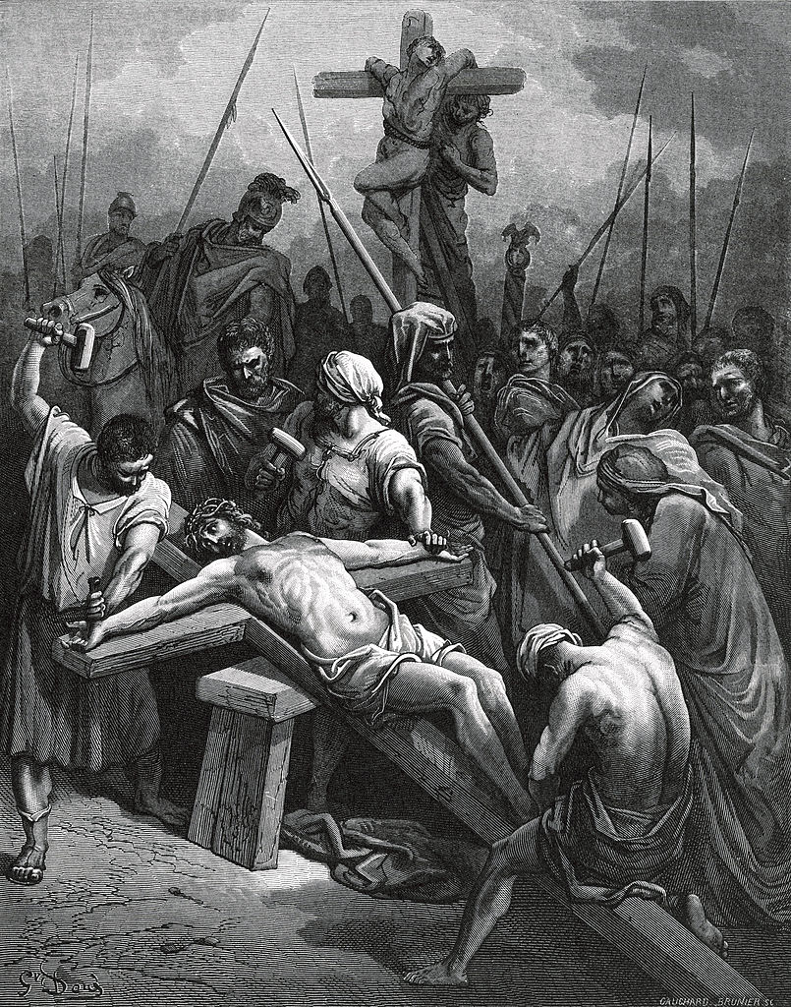
Crucifixion of Jesus
(wood engraving,
1866 by Gustave Doré)

Slide 27
Jesus Models Temperance
Behold my servant, whom I uphold,
my chosen, in whom my soul delights;
I have put my Spirit upon him;
he will bring forth justice to the nations.
He will not cry aloud or lift up his voice,
or make it heard in the street;
a bruised reed he will not break,
and a faintly burning wick he will not quench;
he will faithfully bring forth justice.
He will not grow faint or be discouraged
till he has established justice in the earth;
and the coastlands wait for his law.
Isaiah 42:1-4

