Slide 1
1 Corinthians 15:1-8, 58
April 19, 2020

Slide 2
Jesus appears to many
Jesus met Mary Magdalene outside the empty tomb (John 20:14-18)
Jesus appears to the disciples in the locked room (John 20:19); “Peace be with you”
Jesus appears to two as they walk to Emmaus (Luke 24:13-35)
Jesus appears to the disciples beside Lake Galilee (John 21:4-14); he cooks them breakfast

Slide 3
Jesus appears to many
Jesus presented himself to his disciples and “gave them many convincing proofs that he was alive.” (Acts 1:3)
Jesus ascended on the 40th day, witnessed by the disciples (Acts 1:9)
The disciples returned to Jerusalem, joining “together constantly in prayer” (Acts 1:14)

Slide 4
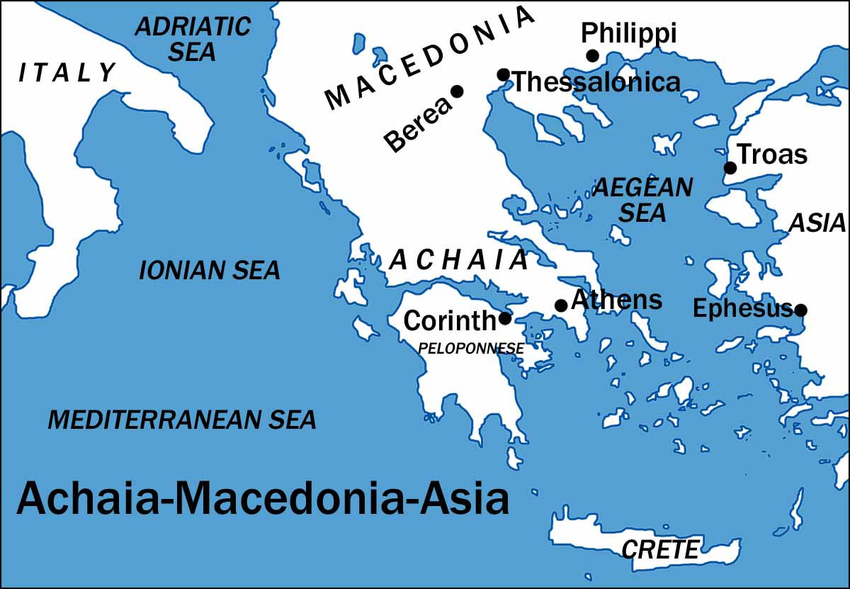

Slide 5
Paul’s first letter to Corinthians
Paul spent 18 months in Corinth during his second missionary journey (Acts 18: 1-18) in about 50 AD
He wrote this letter to them in about 52 or 53 AD
Corinth was a Roman city in southern Greece
Greeks did not believe in the resurrection of the body – this thinking was influencing some within the church (1 Corinthians 15:12)

Slide 6
The Essential Truths
(v3-5)
Paul received these truths, he taught them, and the Corinthian church believed them (1 Corinthians 15:1)
That Christ died for our sins according to the Scriptures
That he was buried
That he was raised on the third day according to the Scriptures
That he appeared to Cephas and then to the Twelve

Slide 7
Witnesses of the risen Jesus
(v6-8)
Over 500 people at the same time
James (likely Jesus’ brother) - see Acts 1:14
Paul on the road to Damascus – see Acts 9:5
Like the Corinthian church, we have received these witness reports, and we have believed them

Slide 8
Significance of the resurrection (v12-19)
How can you believe in the resurrection of Jesus but deny your own resurrection? (v12)
“If there is no resurrection of the dead, then not even Christ has been raised” (v13)
“Then our preaching is useless and so is your faith” (v14)
We are false witnesses about God (v15)

Slide 9
Significance of the resurrection (v20-28)
Since Christ has been raised, then all believers will be resurrected also (v22-23)
He has destroyed death (v26)

Slide 10
Significance of the resurrection (v35-57)
How are the dead raised, and with what kind of body will they come? (v35)
Analogy of the seed and the plant
“The body that is sown is perishable, it is raised imperishable .… It is sown a natural body, it is raised a spiritual body” (v42-44)
We will bear the image of the heavenly (v49)

Slide 11
Putting on imperishability
“I am the resurrection and the life. Anyone who believes in me will live, even though they die; and whoever lives by believing in me will never die.” (John 11:25-26)
“He always lives to intercede for them” (Hebrews 7:25)
“Whoever believes in him shall not perish but have eternal life” (John 3:16)

Slide 12
Standing Firm (v58)
“Therefore, my dear brothers and sisters, stand firm. Let nothing move you. Always give yourselves to the work of the Lord, because you know that your labour in the Lord is not in vain.”

Slide 13
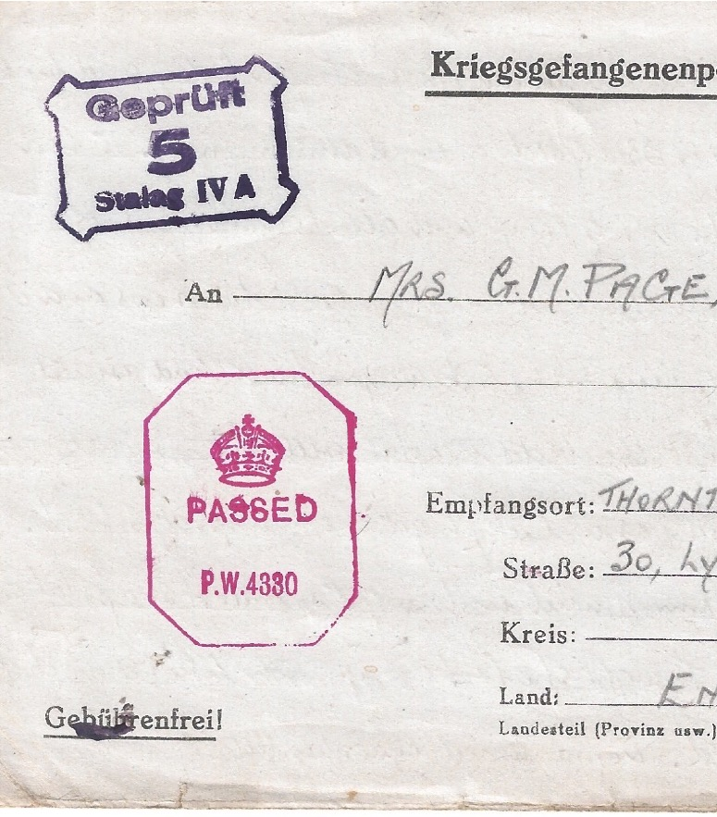
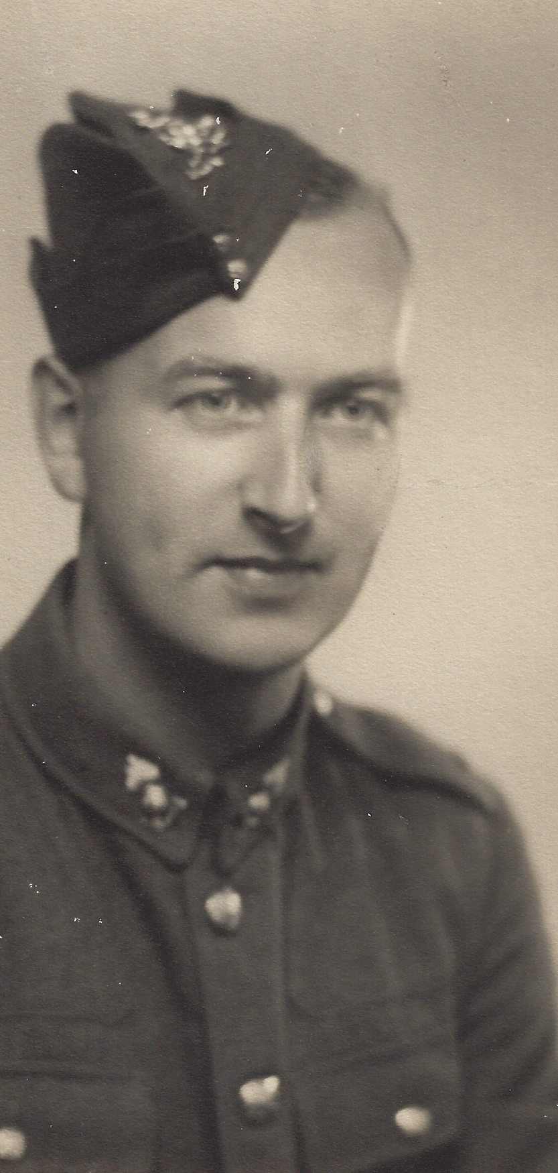
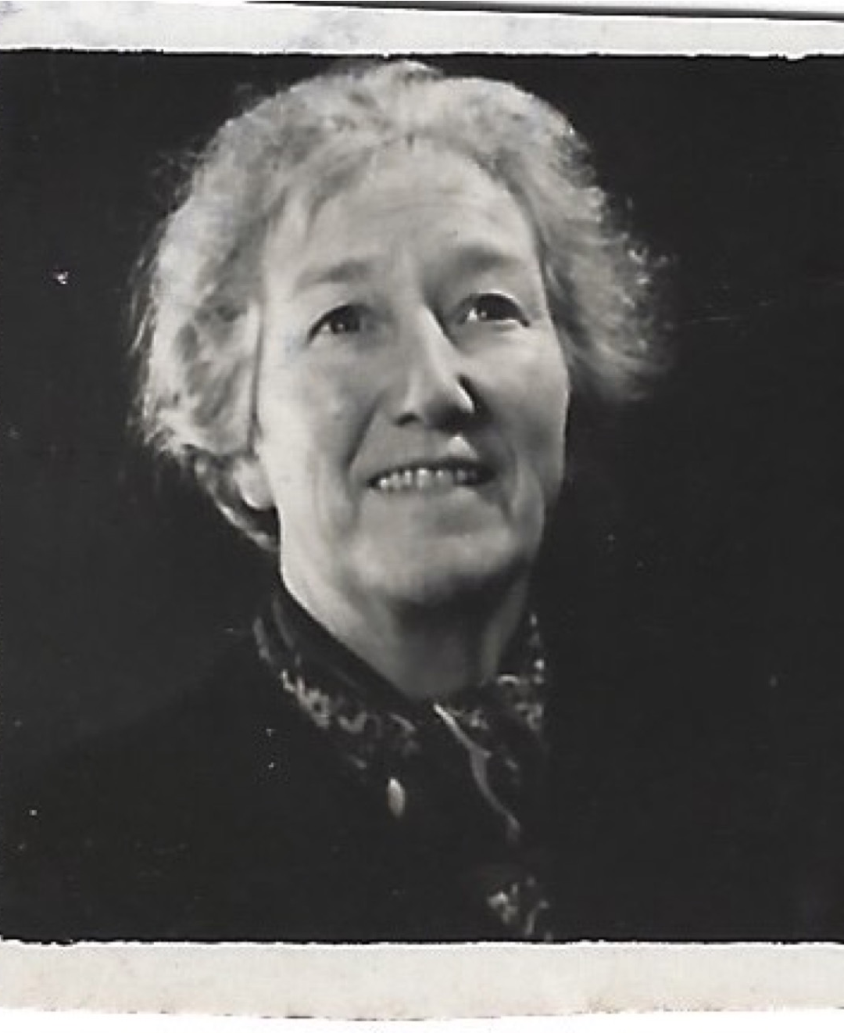
Letters from a POW
88 letters and postcards from my father to his mother, written from a POW camp 1941-45

Slide 14
Standing Firm
“Rejoice always, pray continually, give thanks in all circumstances; for this is God’s will for you in Christ Jesus.” (1 Thessalonians 5:16-18)
“Do not put out the Spirit’s fire.” (v19)

Slide 15
Standing Firm
“God will supply all your needs according to the riches of his glory in Christ Jesus” (Philippians 4:19)
“For we are God’s handiwork, created in Christ Jesus to do good works, which God prepared in advance for us to do” (Ephesians 2:10)

