Slide 1
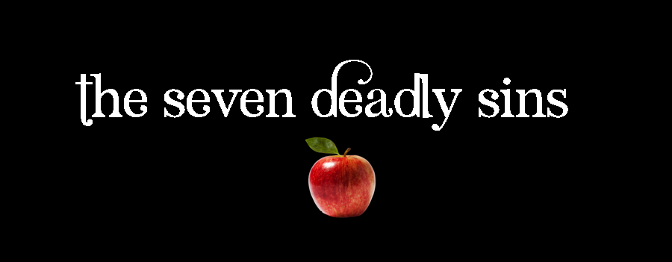
5. Envy
Mark 7:14-23
p. 929

Slide 2
Humility, Honesty, Insight
Clarification:
  Compare 7 Sins with 10 Commandments – – not a direct correlation
  Very serious sins (e.g. murder) not mentioned
  Where do the Seven Deadly Sins come from?
  Speaks to three very important heart attitudes

Slide 3
1. Insights of the Humble
Early Church sought God with all their hearts
Instruction: “confess to one another” (Jas 5:16)
Exhibited 3 characteristics:
  Humble – confessed struggles and failings
  Honest – not hiding anything
  Insightful – Scripture, contemplation, prayer

Slide 4
1. Insights of the Humble …
Jesus’ summary – Love God & neighbor
  Common threads simplified to 7 key issues
First characteristic: common, hard to overcome
  Stumbling blocks that tripped up the faithful
  Some serious sins (murder) not hard to avoid
  Besetting sins wore the faithful down
  Required: vigilance, correction, daily struggle

Slide 5
1. Insights of the Humble …
Second characteristic: Insidious
  Hard to detect & measure
  Reflect dispositions of the heart
  Can be disguised, appear noble.

Slide 6
1. Insights of the Humble …
A word of encouragement:
  Sins that earnest people struggled with
  Identifying them helped their journey of faith
  Battling these sins at the heart of Christian Life
  If you resist, you can experience victory (Jas 4:7)

Slide 7
2. Envy: Covetousness & Impotence
Envy – not easy definition.
  Foundational aspects: Covetousness & Impotence
COVETOUSNESS
“To desire what another has”
  Competition for jobs, awards, success, appearance
  A sense of lack – not being/having what we want

Slide 8
2. Envy: Covetousness & Impotence …
IMPOTENCE
We are powerless to get it
Desiring & powerlessness – coveting & impotence - leads to envy.

Slide 9
2. Envy: Covetousness & Impotence …
ENVY
Desiring something we do not have, resentment at not having it, bitterness against the one who does.

Slide 10
2. Envy: Covetousness & Impotence …
Not only desiring what another has, but also desiring that they not have it.
Desire to be the top – not as good as: better
Sense of worth/self, intertwined with what we desire
  It redefines who we are … it is a rejection of God

Slide 11
3. Envy: Rejection of God
Not being God: we are creatures, life is a gift
CREATURELINESS
Made by a loving creator –
  Share common humanity
  A unique blend of giftings, abilities, appearance

Slide 12
3. Envy: Rejection of God …
Resent who we are … entitlement: to be other
  Bitter towards God & others – have what we want
  Jesus: “love God & others” – envy defies both
  Lose sight of creatureliness … all is Gift

Slide 13
3. Envy: Rejection of God …
GIFT
We have been made who we are
We have been placed where we are
What another is / has – between them & God
Our purpose: Be what God intended us to be

Slide 14
3. Envy: Rejection of God …
GIFT
  We have been made who we are
  We have been placed where we are
  What another is / has – between them & God
Our purpose: Be what God intended us to be
  To reject this, resent it, rebel against it – reject God
  Envy is very dangerous. Deadly!

Slide 15
– Living it –
Cure for envy – LOVE (Charity)
Attributes we should cultivate in our own lives
HUMILITY
Admit our failings & weaknesses
  Others to hold us accountable & to encourage us
False front / spiritual veneer does not help

Slide 16
– Living it –
HONESTY
BCP: “… not dissemble nor cloak them …”
  Dissemble: disguise, justify, minimize
  Cloak: try to hide
God knows what we have done and thought
  He has paid and forgiven them in Christ
  No upside to being dishonest

Slide 17
– Living it –
Putting a spin on things is part of daily life
  Put best interpretation on actions/thoughts
  Break out of this culturally endorsed mentality
Honesty is key to overcoming sin.

Slide 18
– Living it –
INSIGHT
Built upon humility & honesty
Careful contemplation, know Scripture, see intersections with life
Takes time, quiet, wisdom

