Slide 1
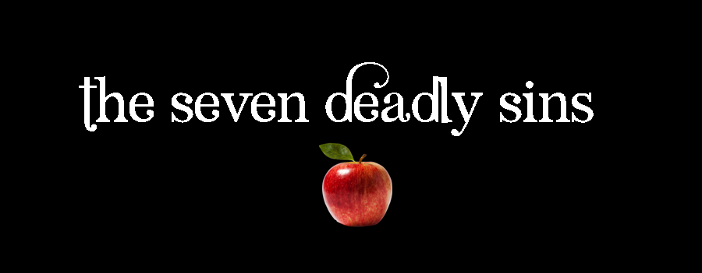
2. GREED
Luke 12:13-21
p. 961

Slide 2
Dispositions
“Evil dispositions which motivate us to sin”
  Become habits, patterns of thought & behavior
Greed has incredible power to harm
  Motivator of raw capitalism & rapacious practices
  In individuals – consumption, excess, injustice

Slide 3
Definition
“A selfish and excessive desire for more of something than is needed”

Slide 4
1. Wealth is not Greed
Bible is nuanced about money & possessions
  Godly to provide for family (1 Tim 5:8)
  And to have something to share (Eph 4:28)
Being able to earn, save, live, is gift & reward
  Proverbs 10:22, 21:5, 20.

Slide 5
1. Wealth is not Greed …
Wealth is fleeting & dangerous (Prov 24:4-5)
  Life is not about abundant possessions (Luke 12:15)
God is generous to us (Deut 14:22-27)
  Bring tithe for extravagant annual party (v 26)
Use of money should be generous, benevolent

Slide 6
1. Wealth is not Greed …
Expansive worship is beautiful (Matt. 26:6-13)
  Generosity towards God is part of worship
Greed is about hoarding money, not using it.
It is about trusting money, not God

Slide 7
2. Greed as Idolatry
  Wealth makes us very comfortable
  Wealth makes us self-sufficient
Prov. 30:8-9
  Don’t give me too much – I may forget you
  Don’t give me too little – I may dishonour you

Slide 8
2. Greed as Idolatry
The man building bigger barns got it wrong
  He was trying to secure his own future
  He put his faith in his accumulated wealth
Paul says greed is idolatry (Eph 5:5, Col 3:5)
Jesus said - cannot serve 2 masters (Matt 6:24)

Slide 9
2. Greed as Idolatry …
Greed is when money usurps God & others
  Two commands – love God, love neighbour (Mk 12:29)
  Generosity to the needy (Deut. 15:11, 1 Jn 3:17)
Having money is not the problem – hoarding it

Slide 10
3. Greed as Slavery
Providing for ourselves easier than trusting God
  Being self-sufficient – know how much is enough
  Fruitless – Ps 39:6
  Unsatisfying – Eccles 5:10
Trusting wealth – unending need to build it
  This drive to accumulate / preserve is slavery

Slide 11
3. Greed as Slavery …
Jesus and the widow’s offering (Luke 21:1-4)
  Woman took a risk. God would supply.
  Rich gave what they could spare.
  A big difference of heart.

Slide 12
3. Greed as Slavery …
The irony –
  Humans strive for self sufficiency
  Leads to cycle of accumulation
  Makes us slaves
Mistake of all who fall under spell of wealth (Eccles. 5:15-16)

Slide 13
– Living it –
Money is not the enemy
  Love of money is (1 Tim 6:10)
Money well used is gift & blessing
  The ending of Eccles 5 – find enjoyment
  God wants us to enjoy it, share it, use it
  A mighty tool for loving God and loving others

Slide 14
– Living it –
Entices us to self-sufficiency & indulgence
  Must be handled with great care (1 Tim 6:6-9)
Two remedies:
  Contentment
  Generosity
Moses’ encouragement –
  remember God (Deut 8:17-18)

