Slide 1
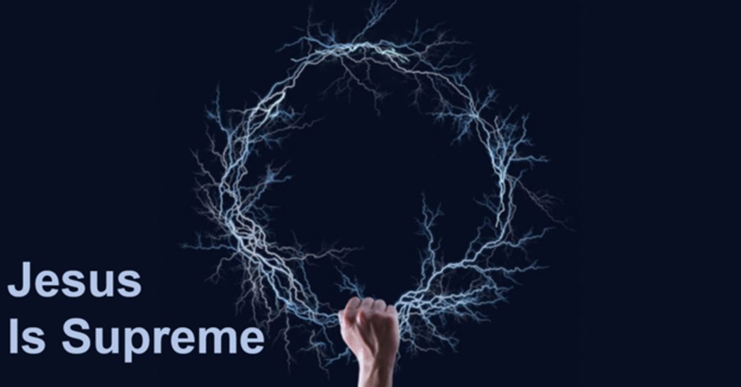
A Great Saviour
Hebrews 2:1-18 (p.1107)

Slide 2
Chapter 1
Following Christ
  Whatever the cost
  Even through persecution
  Because He is Supreme

Slide 3
A Warning
Pay more careful attention to what we have heard (v.1)
  A strong warning – must!
Why pay attention?
  So that we do not drift away
  For our spiritual safety

Slide 4
A Warning
Drifting
  A boat that is drifting and misses the harbour
  It is dangerous
  Lesser to greater argument (v.2)
  It is serious

Slide 5
A Great Saviour – Humbled and Exalted
He was humbled (v.7, 9)
He died (v. 9)
He was crowned with glory (v.7, 9)
Everything is subject to him (v. 8a, 9)

Slide 6
A Great Saviour – Humbled and Exalted
Why is it important to know these four things?
  We do not yet see all things subjected to him (v. 9)
  It doesn’t seem like Christ is in control at times
  If we have a right theology – know these things – we know his superiority
  We can hold on to our salvation no matter the situation of circumstance

Slide 7
Freedom
We can now fully grasp his purpose in coming
  To identify with us (v. 14)
  To defeat Satan (v. 14)
  To free us from the fear of death (v. 15)

Slide 8
Living It
What does this mean for us today
  Have the right theology of who Christ is
    He was humbled, died, crowned over all and all is in subjection to him
  Pay attention to this theology so you don’t drift away
  Hold fast

Slide 9
Living It
Christ is our great Saviour
The heir of all things
The one through whom the universe was made
The radiance of God’s glory
The exact representation of His Being
The Sustainer of the universe
The one who made purification of sins
The one seated at the right hand of the father

