Slide 1
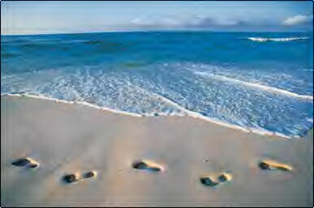

Spiritual Movement for Ecological Justice
Mary had a little lamb

Slide 2
Wind Upon The Waters

Slide 3

Call to gather
Come to the water, all you who thirst—
come drink deeply from the river of life.
Come to the water, all you who are weary—
come rest in the quiet pools of God’s love.
Come to the water, all you who long for justice—
come be renewed in God’s ever-flowing stream.
For God is here among us,
washing away the dust and grime of our lives,
and pouring out the Spirit on all who thirst.
As we gather together.

Slide 4
Opening Prayer

Slide 5
Welcome & Introductions

Slide 6
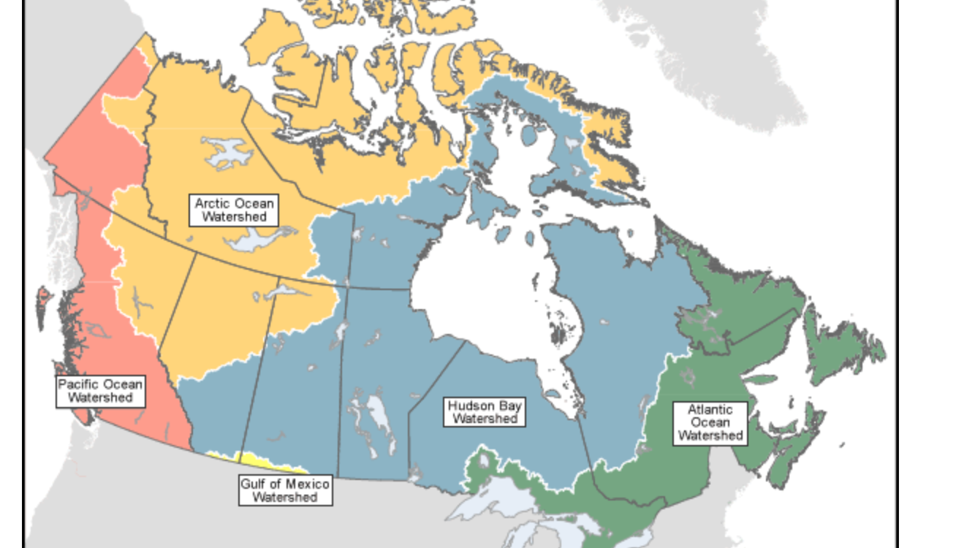

Slide 7
For the Love of Creation

Slide 8
Meditation

Slide 9
Wind Upon The Water
Wind upon the waters, voice upon the deep; rouse your sons and daughters, wake us from our sleep. Breathing life into all flesh, breathing love into all hearts, Living wind upon the waters of my soul.

Slide 10
Wind Upon The Waters (con’t)
Showers from the heavens,
water from the earth,
gift so wholly given,
source of every birth,
joy of every living thing,
making all creation sing,
shower down upon the dry earth of my soul.

Slide 11
Rock and hill and garden, wood and desert sand; Prairie, field and meadow, shaped by Love's own hand. Love that fills the world around, springing up from barren ground, Grow your love within the garden of my soul.

Slide 12
Meditation

Slide 13
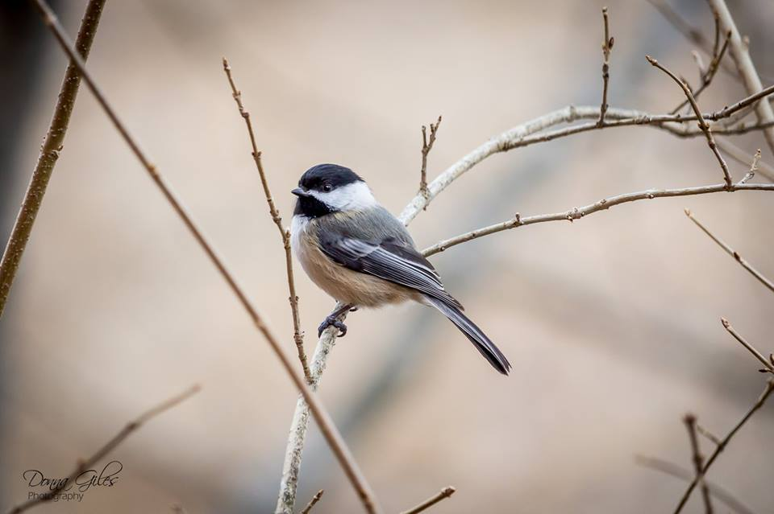

Slide 14
Wind Upon The Waters (Con’t)
Blazing light of wonder, flame that pierces night; Burst the dark asunder, fill our souls with light. Lord of glory, fill the skies, make an end to hatred's cries, Be the blazing Sun of justice in our lives.

Slide 15
Wind upon the waters, rains upon the sand, Grace your sons and daughters, newborn by your hand. Come, O Spirit and renew all the life that comes from you, Send your winds upon the waters of my soul.

Slide 16
Reflection Time

Slide 17
The Peace of Wild Things

Slide 18
Grace: Let All Things Now Living
Let all things now living
a song of thanksgiving to God the creator triumphantly raise, who fashioned and made us,
protected and stayed us, who still guides us on to the end of our days.

Slide 19
Love's banners are o'er us;
God’s light goes before us, a pillar of fire shining forth in the night, till shadows have vanished
and darkness is banished, as forward we travel from light into Light.

Slide 20
Lunch

Slide 21
Let All Things Now Living (con’t)
God’s law still enforces
the stars in their courses and causes the sun in its splendour to shine; the hills and the mountains,
the rivers and fountains, the deeps of the ocean in praises combine.

Slide 22
We too should be voicing
our love and rejoicing; With glad adoration a song let us raise till all things now living
unite in thanksgiving:
“To God in the highest, hosanna and praise!”

Slide 23


Slide 24
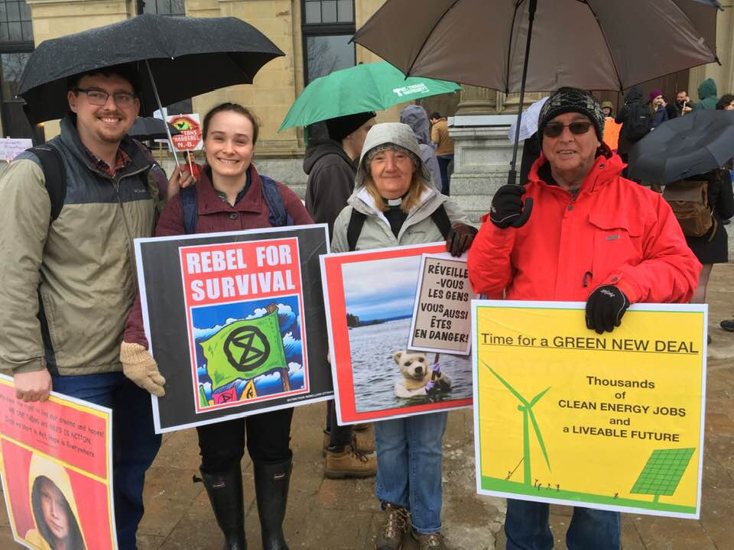

Slide 25
Wind Upon The Waters

Slide 26
Labyrinth

Slide 27
Wind Upon The Waters

Slide 28
Talking Circle
Your first memory of water.
What do you understand to be the link between water and spirituality?
Why is water important to you?
Why/how were you called to environmental issues?
What is on your heart and mind today as we reflect on the sacredness of water and all of creation?

Slide 29
God of the Sparrow
God of the sparrow
God of the whale
God of the swirling stars
How does the creature say Awe
How does the creature say Praise

Slide 30
God of the earthquake
God of the storm
God of the trumpet blast
How does the creature cry Woe
How does the creature cry Save

Slide 31
God of the Sparrow (con’t)
God of the hungry
God of the sick
God of the prodigal
How does the creature say Care
How does the creature say Life

Slide 32
God of the neighbor
God of the foe
God of the pruning hook
How does the creature say Love
How does the creature say Peace

Slide 33
Renewing our Commitment

Slide 34
Commission & Benediction

Slide 35
God Who Gives to Life Its Goodness
God who fills the earth with beauty,
God who binds each friend to friend,
giver of all human talent,
God who wills that chaos end:
grant us now creative spirits,
minds responsive to your mind,
hearts and wills your rule extending,
all our acts by love refined.

Slide 36
“An Invitation from the Earth”

Slide 37
Wind upon the waters

Slide 42
Psalm 104:1, 5-15, 24, 27-28, 31
Praise the Lord!
O Lord my God, how great you are!
You placed the world on its foundation
so it would never be moved.
You clothed the earth with floods of water—
water that covered even the mountains.

Slide 43
At your command, the water fled;
at the sound of your thunder, it hurried away.
Mountains rose and valleys sank
to the levels you decreed.

Slide 44
You send rain on the mountains
from your heavenly home,
and you fill the earth with the fruit of your labor.
You cause grass to grow for the livestock
and plants for people to use.
You allow them to produce food from the earth—
wine to make them glad,
olive oil to soothe their skin,
and bread to give them strength.

Slide 45
O Lord, what a variety of things you have made!
In wisdom you have made them all.
The earth is full of your creatures.
They all depend on you to give them food
as they need it.
When you supply it, they gather it.
You open your hand to feed them,
and they are richly satisfied.
May the glory of the Lord continue forever!
May the Lord take pleasure in all that has been made!

