Slide 1
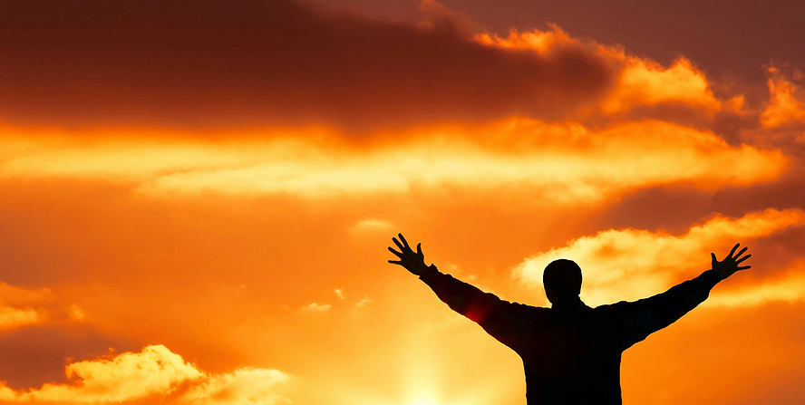
Joy. Peace. Life.
PHILIPPIANS
Press on towards the Goal
Philippians 4:1-23

Slide 2
Baptism … In Christ
Baptism –
  Unites us with Christ … makes us new creations
  Our old rebellious nature dies (Rom 6:6)
  We are made alive to God in Christ Jesus
Being Christian is about being “in Christ”
  7x in ch. 4 Paul talks of being “in the Lord/Christ”

Slide 3
1. Joy
“Rejoice in the Lord” (v 4)
  Not “Rejoice” but Rejoice in the Lord”
  Overriding theme: sufficiency of the Gospel
  Described most powerfully in ch. 2
Paul is in prison – Roman soldiers are guards
  Her is rejoicing in spite of circumstances (v 11-13)
  He’s strengthened by Christ through the Holy Spirit

Slide 4
1. Joy …
UN Happiness index
  156 countries
  USA increasing income for 50 years – declining happiness
  No connection – wealth/comfort & happiness
Paul – “whatever situation – I am content”
  It is a miracle – built on what God has done

Slide 5
2. Peace
How do we experience peace? (v 6-7)
  Lay aside Anxiety through PRAYER
  Characterized by SUPPLICATION & THANKSGIVING
  PEACE guards our HEARTS and MINDS
  Because we are “IN CHRIST JESUS”
Anxiety – most common mental illness
  A solution is a critical health issue
  Through prayer we lay it aside

Slide 6
2. Peace …
Supplication & Thanksgiving
  Prayer to the God revealed in Jesus Christ
  Lay our requests at God’s feet
    What happens is in his hands and he is good
  Come with thanksgiving
    Reminding ourselves of all we have in Christ (Rev 21:4)

Slide 7
2. Peace …
Results in PEACE that passes all understanding
  Peace is a fruit of the Holy Spirit (Gal 5:22)
  An outflowing of walking with Christ
  Prophets warn against worldly promises of peace
  Promising Peace apart from God is a lie
Peace comes from being “in Christ Jesus” (v 7)

Slide 8
3. Life
“Think about these things” (v 8)
  “true, honourable, just, pure, lovely, commendable, excellent, worthy of praise”
  An instruction to think rightly
    Counsellors – helping clients change the way they think
  Problem: focus is ourselves
  We must look UPWARD (to God)
    Look to God – who he is, what he has done
    Train ourselves to live oriented to God

Slide 9
3. Life …
It also matters how we live
  Practice all we have learned, received, heard, seen
  Take the Bible seriously
  Take what God has done, and is doing seriously
  Not doing so is to forget what you look like (Jas 1:23)

Slide 10
Living It
Unity
  Appeal to Euodia & Syntyche to “agree in the Lord”
  Key to being a community of God’s people
  Being a doer is not individualistic
    Live in peace & mutual submission in midst of diversity
  “True companion” (Luke) the help
    Apostlically appointed overseer to facilitate peace
    Self-appointed leaders bringing division contradicts this
    New life in Christ: humility and mutual submission

