Slide 1
1. The Blessed King
Psalm 72:1-19
p. 1048

Slide 2
¹⁻⁸ Give the gift of wise rule to the king, O God,
the gift of just rule to the crown prince.
May he judge your people rightly,
be honorable to your meek and lowly.
Let the mountains give exuberant witness;
shape the hills with the contours of right living.
Please stand up for the poor,
help the children of the needy,
come down hard on the cruel tyrants.
Outlast the sun, outlive the moon—
age after age after age.
Be rainfall on cut grass,
earth-refreshing rain showers.
Let righteousness burst into blossom
and peace abound until the moon fades to nothing.
Rule from sea to sea,
from the River to the Rim.

Slide 3
⁹⁻¹⁴ Foes will fall on their knees before God,
his enemies lick the dust.
Kings remote and legendary will pay homage,
kings rich and resplendent will turn over their wealth.
All kings will fall down and worship,
and godless nations sign up to serve him,
Because he rescues the poor at the first sign of need,
the destitute who have run out of luck.
He opens a place in his heart for the down-and-out,
he restores the wretched of the earth.
He frees them from tyranny and torture—
when they bleed, he bleeds;
when they die, he dies.

Slide 4
¹⁵⁻¹⁷ And live! Oh, let him live!
Deck him out in Sheba gold.
Offer prayers unceasing to him,
bless him from morning to night.
Fields of golden grain in the land,
cresting the mountains in wild exuberance,
Cornucopias of praise, praises
springing from the city like grass from the earth.
May he never be forgotten,
his fame shine on like sunshine.
May all godless people enter his circle of blessing
and bless the One who blessed them.
¹⁸⁻²⁰ Blessed God, Israel’s God,
the one and only wonder-working God!
Blessed always his blazing glory!
All earth brims with his glory.
Yes and Yes and Yes.

Slide 5
Psalm 72
Since the time of Bernard of Clairvaux (1153) Christians have spoken of the three comings of Christ: in the flesh in Bethlehem, in our hearts daily, and in glory at the end of time. The first of these comings was visible in the weakness of a human infant; the second is invisible but in spirit and power; the third in glory and majesty will be visible to everyone.
- Philip Pfatteicher [FAH-ta-ker]

Slide 6
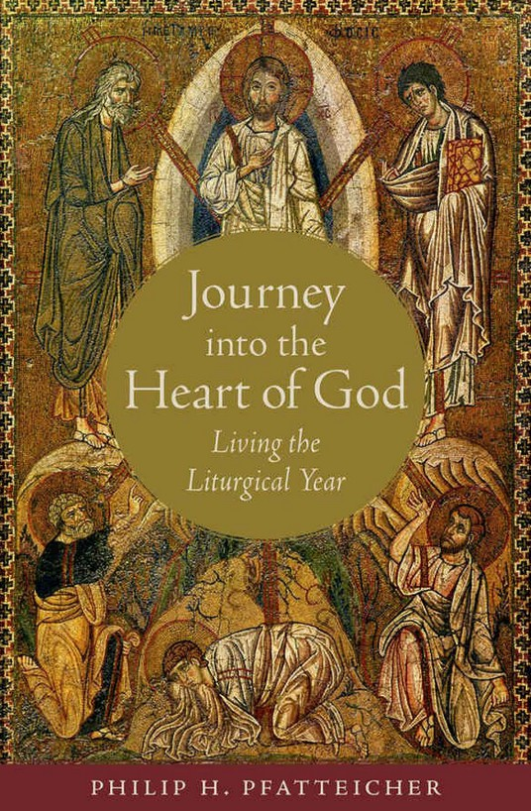

Slide 7
Psalm 72
Psalm of hope
Justice and restoration
Royal Psalm (coronation proclamation)
Really awkward coronation
Messianic?

Slide 8
Psalm 72
It’s not too late
Draw near to the Blessed King
Switch gears, slow down

Slide 9
1. Consider the person of Christ reflected in the qualities of the Blessed King in Psalm 72
King of justice (v1)
Righteous judge (v2)
Restoration (v3)
Defender of the needy (v4)

Slide 10
1. Consider the person of Christ reflected in the qualities of the Blessed King in Psalm 72
The people are precious to the King
The Spirit of the Sovereign Lord is on me,
because the Lord has anointed me
to proclaim good news to the poor.
He has sent me to bind up the brokenhearted,
to proclaim freedom for the captives
and release from darkness for the prisoners – Isa 61
Christ fits into the frame

Slide 11
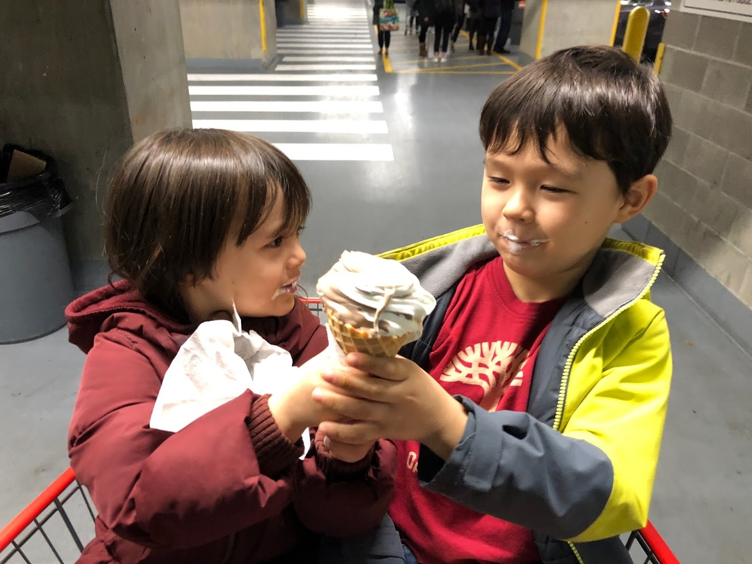

Slide 12
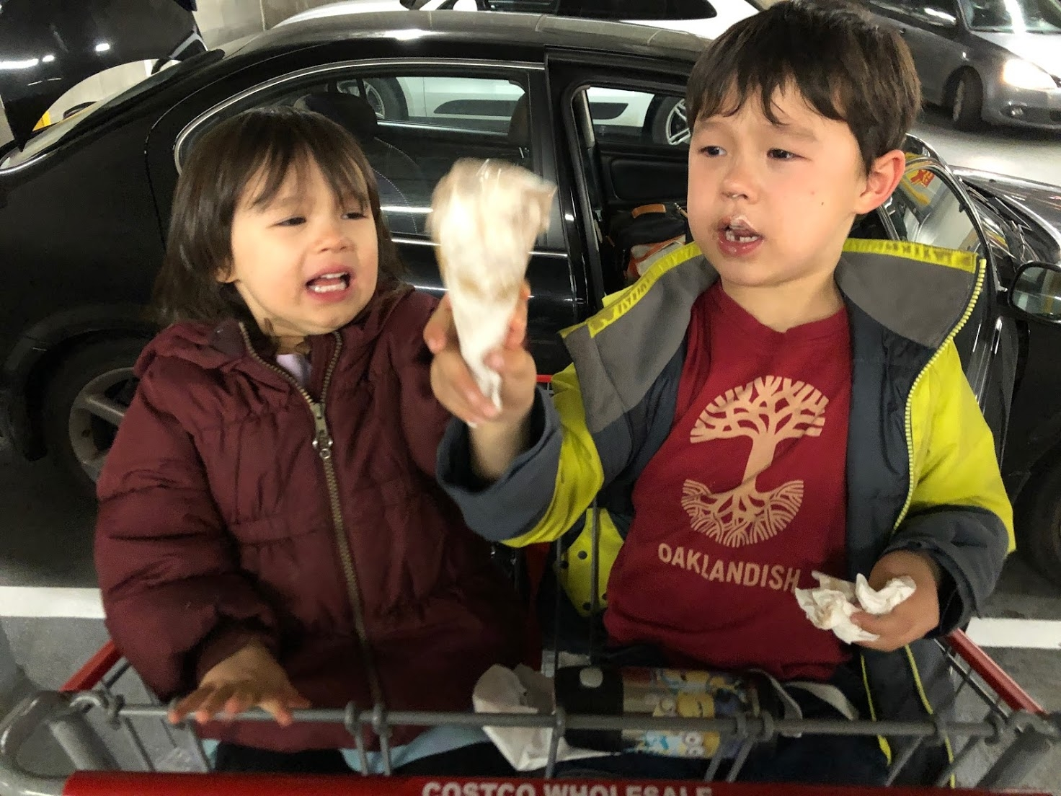

Slide 13
1. Consider the person of Christ reflected in the qualities of the Blessed King in Psalm 72
Extra bed people
Frustration in waiting

Slide 14
2. Consider joining with the Psalmist in longing for the reign of the Blessed King in Psalm 72
People are resolute, devoted, and hopeful
World is longing..
For his rule (v 8),
For total submission from earthly rules (v9-11),
His name endures forever (vs 16).

Slide 15
2. Consider joining with the Psalmist in longing for the reign of the Blessed King in Psalm 72
The king is the solution for brokenness
We have met the king
Our longing increases

Slide 16
2. Consider joining with the Psalmist in longing for the reign of the Blessed King in Psalm 72
Indeed, the Advent season and its hope should not be regarded purely or even primarily in terms of Christmas. It should not be seen as an introduction to the Incarnation but rather as the completion of the work of redemption. The spirit season is expressed in the impatient cry of a sometimes deperate people, "O that you would tear open the heavens and come down" (Isa 64:1), echoed in the seventeenth-century German hymm O Heilandreiss die Himmel auf (O Saviour, tear open the heavens):
O savior rend the heavens wide;
Come down, come down with mighty stride;
Unlock the gates, the doors break down;
Unbar the way to heaven's crown.

Slide 17
3. Consider responding to the Blessed King this in our worship and in our action.
Bah Humbug Dan

Slide 18
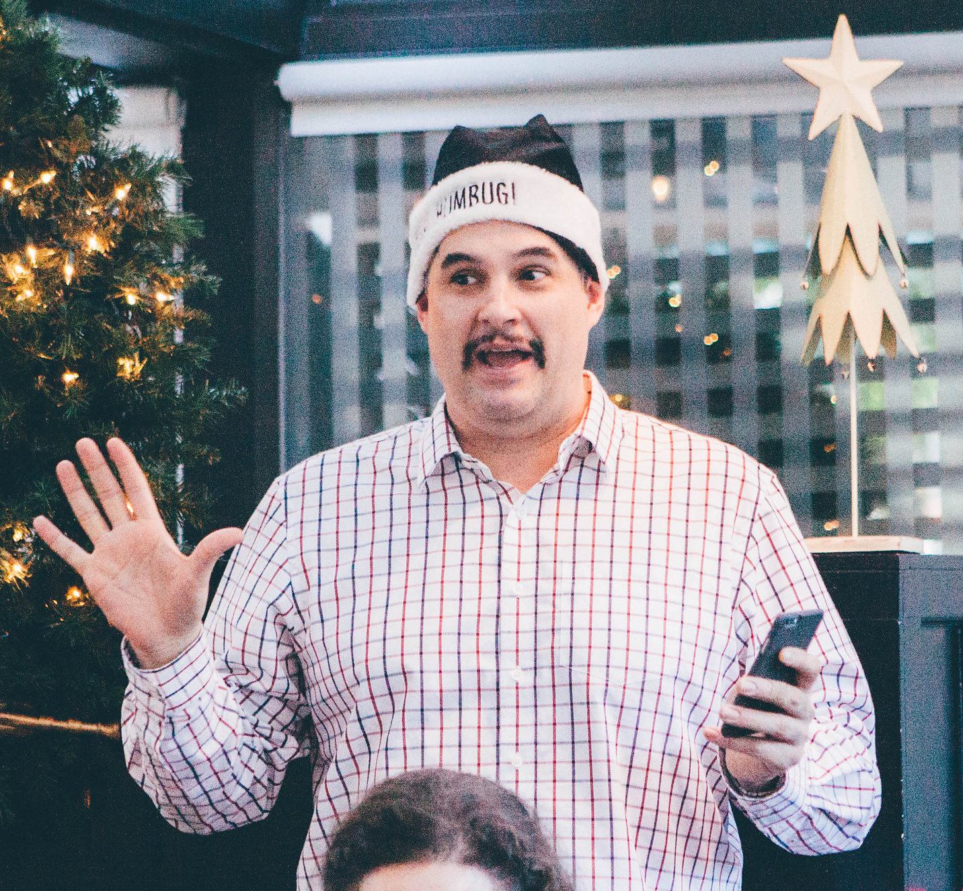


Slide 20
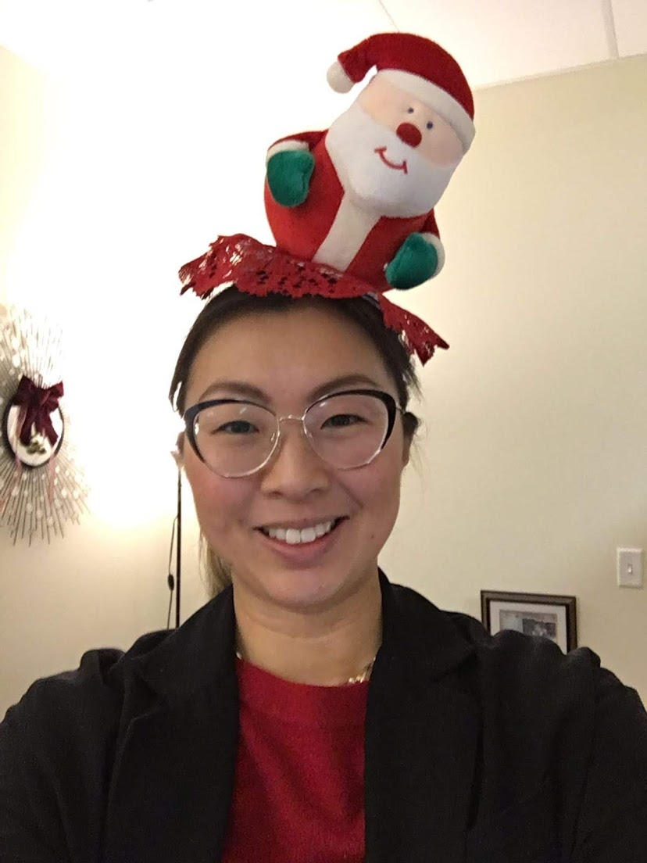

Slide 21
3. Consider responding to the Blessed King this in our worship and in our action.
Bah Humbug Dan
End of year exhausting
Advent is a beginning (ramp up)
Prepare for God’s work in you

Slide 22
Responding to the Blessed
King in our worship
Lectionary Readings
Malcom Guite – Waiting on the Word

Slide 23
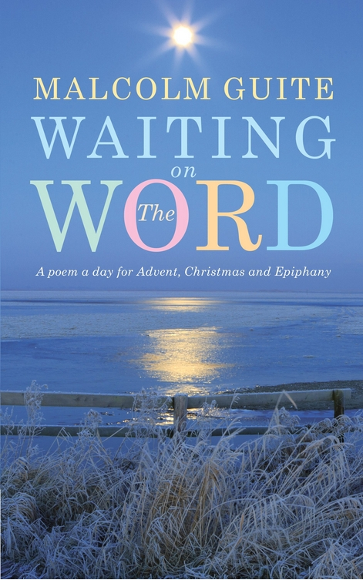

Slide 24
Responding to the Blessed
King in our worship
Lectionary Readings
Malcom Guite – Waiting on the Word
New Leaf Network

Slide 25
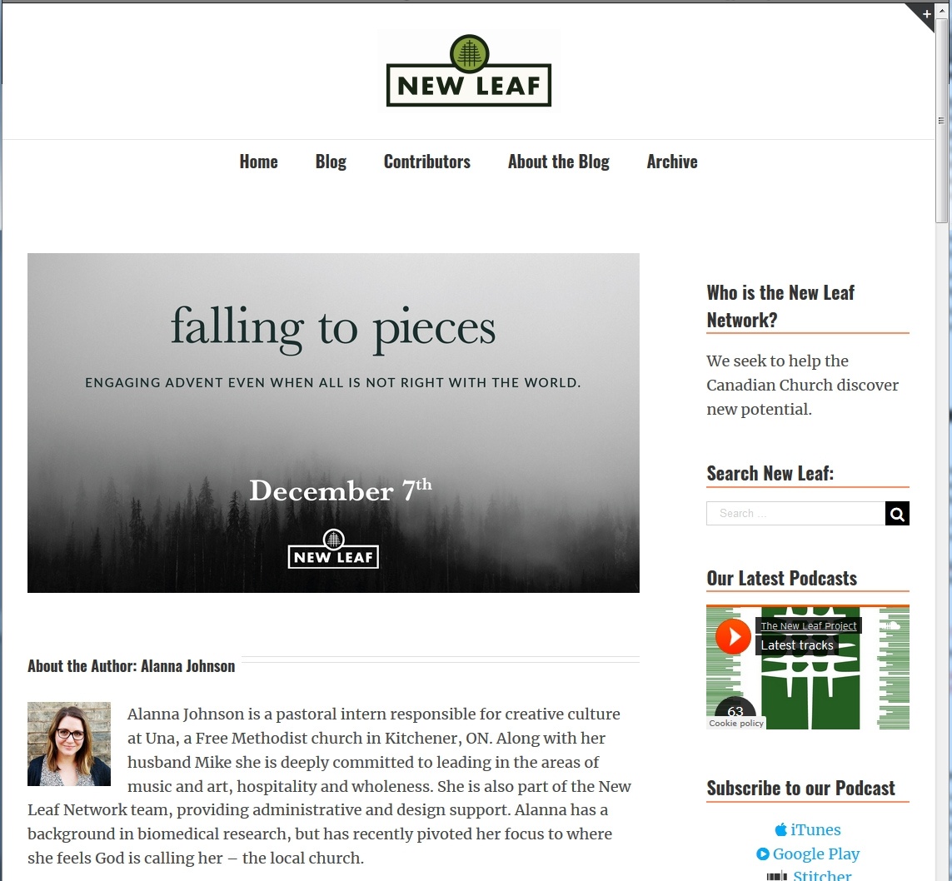

Slide 26
Responding to the Blessed
King in our action
“Advent is when we give voice to the ache and pain and longing in our hearts. Advent is also when we confess our own participation in the brokenness of the world. Advent, then, is not only about longing for Christ to come again and put everything back together; it’s about repenting and receiving grace so that we get to be put back together now.
But there’s one more piece. Advent is not only about longing for Christ to put the world back together, not only about repenting and letting Christ put us back together; it is also a chance to participate in bringing wholeness to others.” – Malcom Guite

Slide 27
Responding to the Blessed
King in our action
The circle of God’s blessing
Advent is the time
We know the king

Slide 28
¹⁸⁻²⁰ Blessed God, Israel’s God,
the one and only wonder-working God!
Blessed always his blazing glory!
All earth brims with his glory.
Yes and Yes and Yes.

