Slide 1

how to live a VERY good life
😋

Slide 2
“Forcing a child into this world, and forcing it to have a career amounts to ‘kidnapping and slavery’.”

Slide 3
Today’s wisdom God’s eternal wisdom
To find yourself, look within yourself
*from the book Good Faith by David Kinnaman & Gabe Lyons

Slide 4
Today’s wisdom God’s eternal wisdom
To find yourself, look within yourself
To find yourself, discover the truth outside yourself, in Jesus.
*from the book Good Faith by David Kinnaman & Gabe Lyons

Slide 5
Today’s wisdom God’s eternal wisdom
To find yourself, look within yourself
People should not criticize someone else’s life choices.
To find yourself, discover the truth outside yourself, in Jesus.
*from the book Good Faith by David Kinnaman & Gabe Lyons

Slide 6
Today’s wisdom God’s eternal wisdom
To find yourself, look within yourself
People should not criticize someone else’s life choices.
To find yourself, discover the truth outside yourself, in Jesus.
Loving others does not always mean staying silent.
*from the book Good Faith by David Kinnaman & Gabe Lyons

Slide 7
Today’s wisdom God’s eternal wisdom
To find yourself, look within yourself
People should not criticize someone else’s life choices.
To be fulfilled in life, pursue the things you desire most.
To find yourself, discover the truth outside yourself, in Jesus.
Loving others does not always mean staying silent.
*from the book Good Faith by David Kinnaman & Gabe Lyons

Slide 8
Today’s wisdom God’s eternal wisdom
To find yourself, look within yourself
People should not criticize someone else’s life choices.
To be fulfilled in life, pursue the things you desire most.
To find yourself, discover the truth outside yourself, in Jesus.
Loving others does not always mean staying silent. Joy is found not in pursuing our own desires but in giving of ourselves to bless others.
*from the book Good Faith by David Kinnaman & Gabe Lyons

Slide 9
Today’s wisdom God’s eternal wisdom
Enjoying yourself is the highest goal in life.
*from the book Good Faith by David Kinnaman & Gabe Lyons

Slide 10
Today’s wisdom God’s eternal wisdom
Enjoying yourself is the highest goal in life.
The highest goal of life is giving glory to God.
*from the book Good Faith by David Kinnaman & Gabe Lyons

Slide 11
Today’s wisdom God’s eternal wisdom
Enjoying yourself is the highest goal in life.
People can believe whatever they want, as long as those beliefs don’t affect society.
The highest goal of life is giving glory to God.
*from the book Good Faith by David Kinnaman & Gabe Lyons

Slide 12
Today’s wisdom God’s eternal wisdom
Enjoying yourself is the highest goal in life.
People can believe whatever they want, as long as those beliefs don’t affect society.
The highest goal of life is giving glory to God.
God gives people the freedom to believe whatever they want, but those beliefs always affect society.
*from the book Good Faith by David Kinnaman & Gabe Lyons

Slide 13
Today’s wisdom God’s eternal wisdom
Enjoying yourself is the highest goal in life.
People can believe whatever they want, as long as those beliefs don’t affect society.
Any kind of sexual expression between two consenting adults is fine.
The highest goal of life is giving glory to God.
God gives people the freedom to believe whatever they want, but those beliefs always affect society.
*from the book Good Faith by David Kinnaman & Gabe Lyons

Slide 14
Today’s wisdom God’s eternal wisdom
Enjoying yourself is the highest goal in life.
People can believe whatever they want, as long as those beliefs don’t affect society.
Any kind of sexual expression between two consenting adults is fine.
The highest goal of life is giving glory to God.
God gives people the freedom to believe whatever they want, but those beliefs always affect society.
God designed boundaries for sex and sexuality in order for humans to flourish.
*from the book Good Faith by David Kinnaman & Gabe Lyons

Slide 15
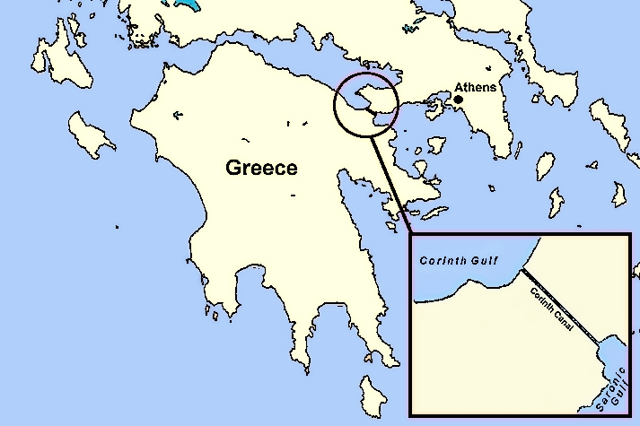

Slide 16
Corinthian wisdom was shaped by
Affluence

Slide 17
Corinthian wisdom was shaped by
Affluence
Sexual freedom

Slide 18
Corinthian wisdom was shaped by
Affluence
Sexual freedom
Patronage support system

Slide 19
Corinthian wisdom was shaped by
Affluence
Sexual freedom
Patronage support system
A philosophical frenzy

Slide 20
Corinthian wisdom was shaped by
Affluence
Sexual freedom
Patronage support system
A philosophical frenzy
Acts 18:4 Every Sabbath he (Paul) reasoned in the synagogue, trying to persuade Jews and Greeks.

Slide 21

Vs 7. God’s Wisdom was LOCKED away

Slide 22
Vs 7. God’s Wisdom was LOCKED away
God’s wisdom is for our glory

Slide 23
When we make good decisions God looks good, and we look good.

Slide 24
1 Corinthians 2:9-10
⁹ However, as it is written:
“What no eye has seen, what no ear has heard, and what no human mind has conceived”— the things God has prepared for those who love him—
¹⁰ these are the things God has revealed to us by his Spirit.

Slide 25
1 Corinthians 2:9-10
⁹ However, as it is written:
“What no eye has seen, what no ear has heard, and what no human mind has conceived”— the things God has prepared for those who love him—
¹⁰ these are the things God has revealed to us by his Spirit.
Isaiah 64:4
⁴ Since ancient times no one has heard, no ear has perceived, no eye has seen any God besides you, who acts on behalf of those who wait for him.

Slide 26
Vs 7. God’s Wisdom was LOCKED away
God’s wisdom is for our glory
Vs. 9. Paul was thinking about waiting on God while he wrote about the Spirit

Slide 27
Hearing from God, involves waiting on God.

Slide 28


Slide 29
Vs 7. God’s Wisdom was LOCKED away
God’s wisdom is for our glory
Vs. 9. Paul was thinking about waiting on God while he wrote about the Spirit
Vs 12. because of Christ, the mystery of God’s wisdom has been unlocked.
Because of Christ, the Spirit of God can be received (into) our lives

Slide 30
Vs 7. God’s Wisdom was LOCKED away
God’s wisdom is for our glory
Vs. 9. Paul was thinking about waiting on God while he wrote about the Spirit
Vs 12. because of Christ, the mystery of God’s wisdom has been unlocked.
Because of Christ, the Spirit of God can be received (into) our lives
ACTIVE NOT PASSIVE

Slide 31
Vs 7. God’s Wisdom was LOCKED away
God’s wisdom is for our glory
Vs. 9. Paul was thinking about waiting on God while he wrote about the Spirit
Vs 12. because of Christ, the mystery of God’s wisdom has been unlocked.
Because of Christ, the Spirit of God can be received (into) our lives
ACTIVE NOT PASSIVE
Vs. 13. The spirit we have received teaches us
“we speak” assumes a community aspect to hearing from the Spirit

Slide 32
We are obligated to utilize Godly wisdom in our daily lives

Slide 33
Romans 11:34
Who has known the mind of the Lord?
Or who has been his counselor?

Slide 34

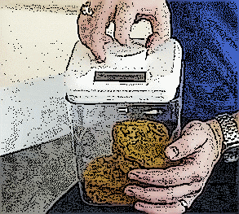
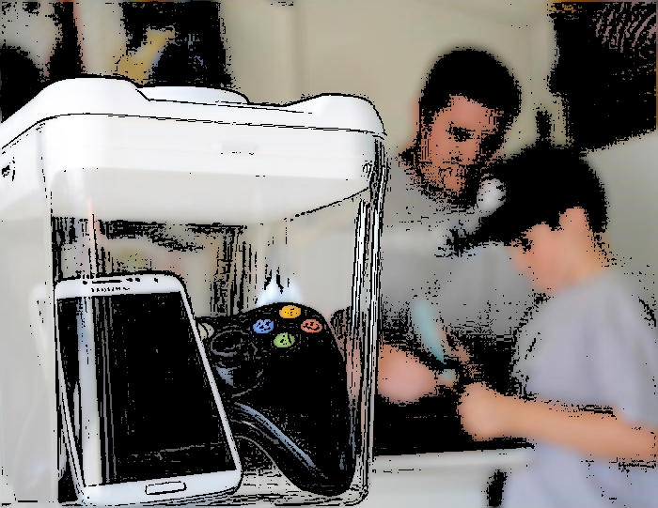
Learn the art of waiting on the Lord
Place your screenshot here
www.kitchensafe.com

Slide 35

Learn the art of waiting on the Lord
www.freedom.to

Slide 36

Unlock your access to the mind of Christ

Slide 37
Unlock your access to the mind of Christ
Am I better at praying out loud and in front of people, than I am when I am alone?

Slide 38
Unlock your access to the mind of Christ
Am I better at praying out loud and in front of people, than I am when I am alone?
Do I measure the quantity of my time spent in listening prayer, practicing the presence of God?

Slide 39
Unlock your access to the mind of Christ
Am I better at praying out loud and in front of people, than I am when I am alone?
Do I measure the quantity of my time spent in listening prayer, practicing the presence of God?
When I allow my mind to wander, where does it wander to?

