Slide 1
The Disciples Saw What ???
1 Corinthians 15:1-11
The four eye witness Tests
applied to the Gospels

Slide 2

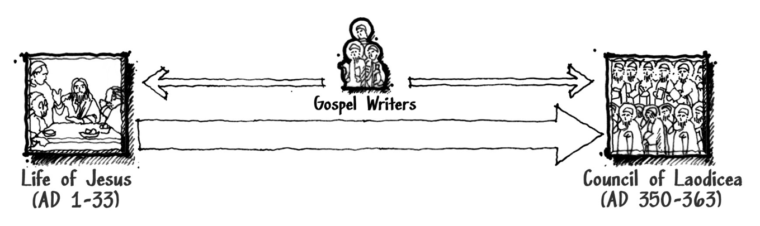
If the Gospels are dated late, the authors were not there when it happened

Slide 3
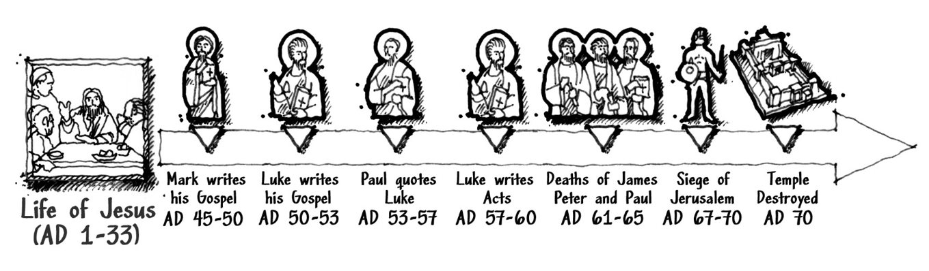

Slide 4
¹ Many have undertaken to draw up an account of the things that have been fulfilled among us, ² just as they were handed down to us by those who from the first were eyewitnesses and servants of the word. ³ With this in mind, since I myself have carefully investigated everything from the beginning, I too decided to write an orderly account for you, most excellent Theophilus, ⁴ so that you may know the certainty of the things you have been taught.
Luke 1:1-4

Slide 5



Slide 6

True eyewitness testimony is typically corroborated in some way

Slide 7
⁶⁷ Then they spit in his face and struck him with their fists. Others slapped him ⁶⁸ and said, “Prophesy to us, Messiah. Who hit you?”
Matthew 26:67-68
⁶³ The men who were guarding Jesus began mocking and beating him. ⁶⁴ They blindfolded him and demanded, “Prophesy! Who hit you?” ⁶⁵ And they said many other insulting things to him.
Luke 22:63-65

Slide 8
True eyewitness testimony is typically corroborated in some way

Slide 9
Josephus (AD 37–101) Described Jesus:
“At this time there was a wise man who was called Jesus. His conduct was good, and [he] was known to be virtuous. And many people from among the Jews and the other nations became his disciples. Pilate condemned him to be crucified and to die. And those who had become his disciples did not abandon his discipleship. They reported that He had appeared to them three days after his crucifixion and that He was alive; accordingly, He was perhaps the Messiah concerning whom the prophets have recounted wonders.”

Slide 10
Thallus (CA. AD 5–60) Described Jesus
On the whole world there pressed a most fearful darkness; and the rocks were rent by an earthquake, and many places in Judea and other districts were thrown down. This darkness Thallus, in the third book of his History, calls, as appears to me without reason, an eclipse of the sun.

Slide 11
Tacitus (AD 56–117) Describes Jesus
Consequently, to get rid of the report, Nero fastened the guilt and inflicted the most exquisite tortures on a class hated for their abominations, called Christians by the populace. Christus, from whom the name had its origin, suffered the extreme penalty during the reign of Tiberius at the hands of one of our procurators, Pontius Pilatus, and a most mischievous superstition, thus checked for the moment, again broke out not only in Judaea, the first source of the evil, but even in Rome, where all things hideous and shameful from every part of the world find their centre and become popular.

Slide 12
Mara Bar-Serapion (AD 70) Described Jesus
What advantage did the Athenians gain from putting Socrates to death? Famine and plague came upon them as a judgment for their crime. What advantage did the men of Samos gain from burning Pythagoras? In a moment their land was covered with sand. What advantage did the Jews gain from executing their wise King? It was just after that that their kingdom was abolished. God justly avenged these three wise men: the Athenians died of hunger; the Samians were overwhelmed by the sea; the Jews, ruined and driven from their land, live in complete dispersion. But Socrates did not die for good; he lived on in the teaching of Plato. Pythagoras did not die for good; he lived on in the statue of Hera. Nor did the wise King die for good; He lived on in the teaching which He had given.

Slide 13
Phlegon (AD 80–140) Described Jesus
Now Phlegon, in the thirteenth or fourteenth book, I think, of his Chronicles, not only ascribed to Jesus a knowledge of future events (although falling into confusion about some things which refer to Peter, as if they referred to Jesus), but also testified that the result corresponded to his predictions. So that he also, by these very admissions regarding foreknowledge, as if against his will, expressed his opinion that the doctrines taught by the fathers of our system were not devoid of divine power.
And with regard to the eclipse in the time of Tiberius Caesar, in whose reign Jesus appears to have been crucified, and the great earthquakes which then took place, Phlegon too, I think, has written in the thirteenth or fourteenth book of his Chronicles.

Slide 14
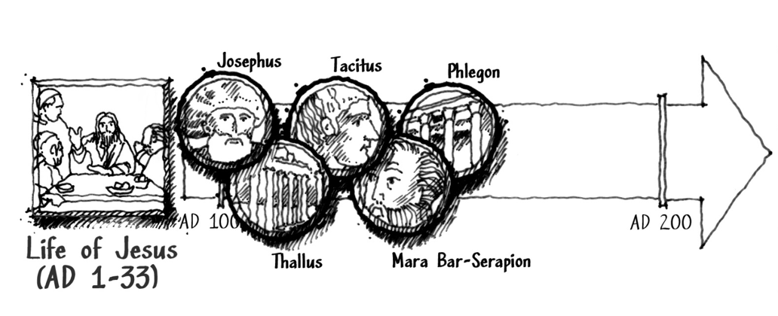

Slide 15
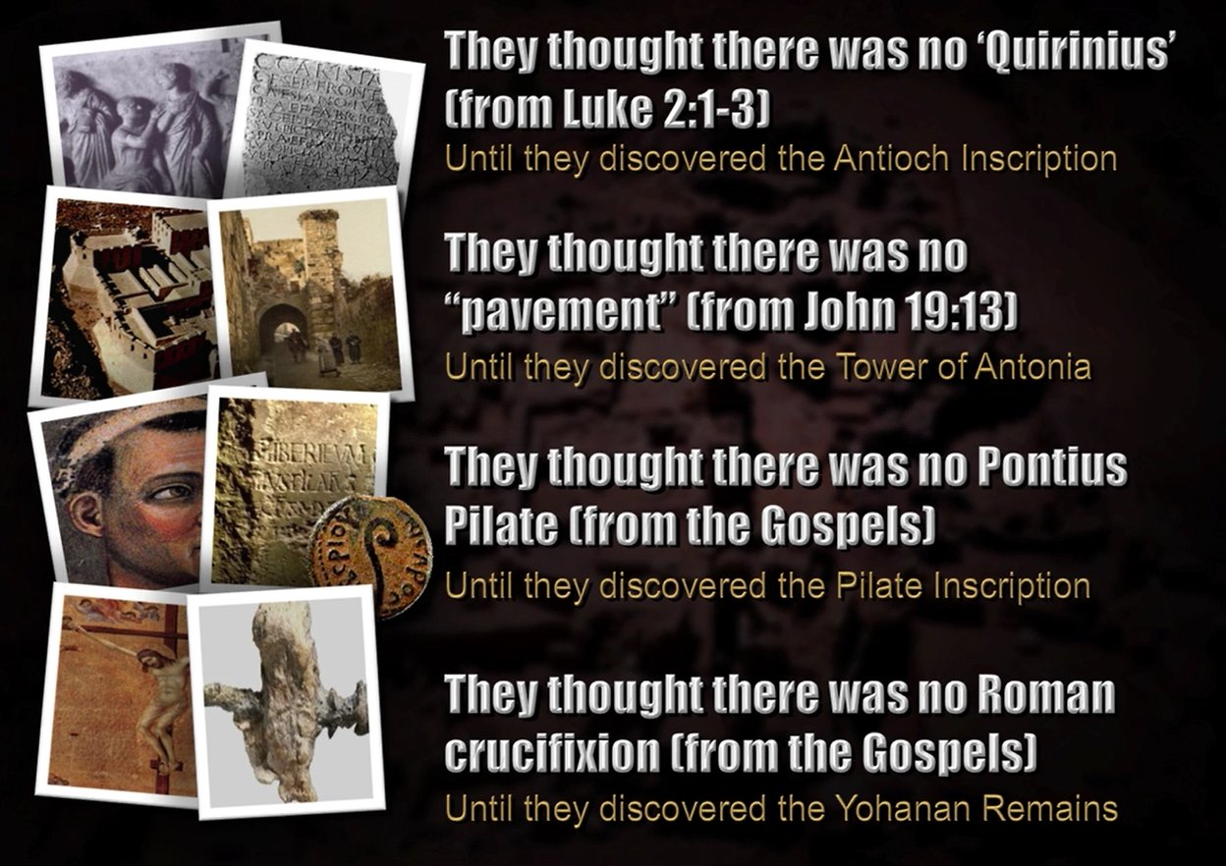

Slide 16
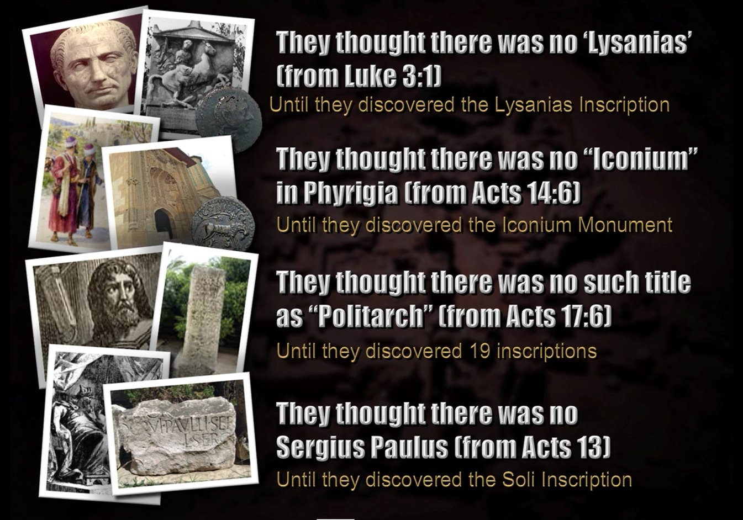

Slide 17
True eyewitness testimony is typically corroborated in some way

Slide 18
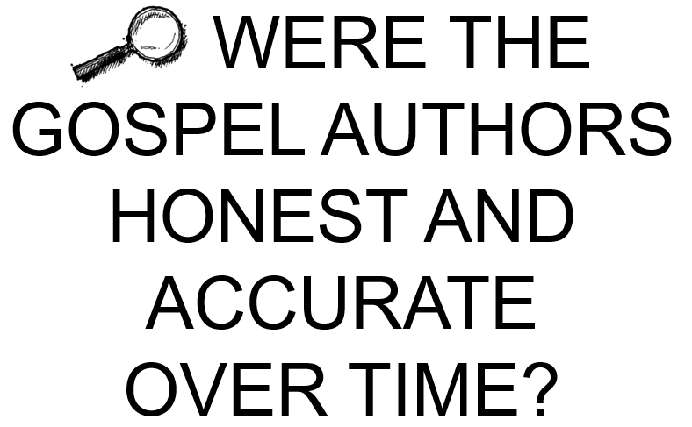
If a witness changes his story over time, he should not be trusted.

Slide 19
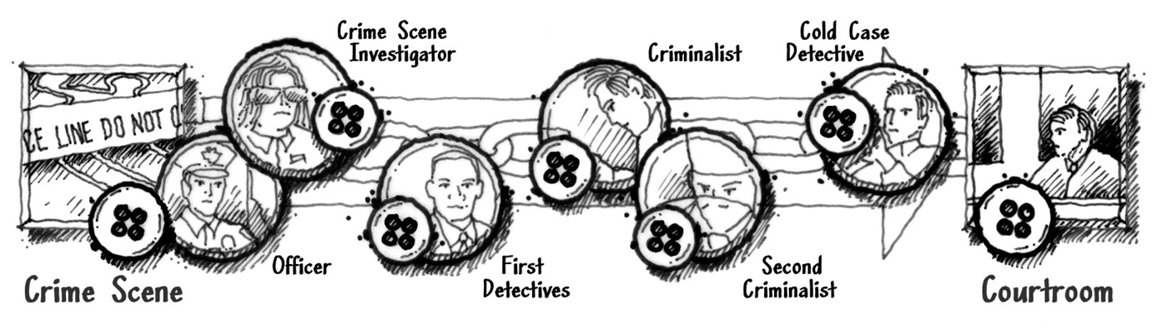
Chain of Custody What is at trial was same as what was found at crime scene.

Slide 20
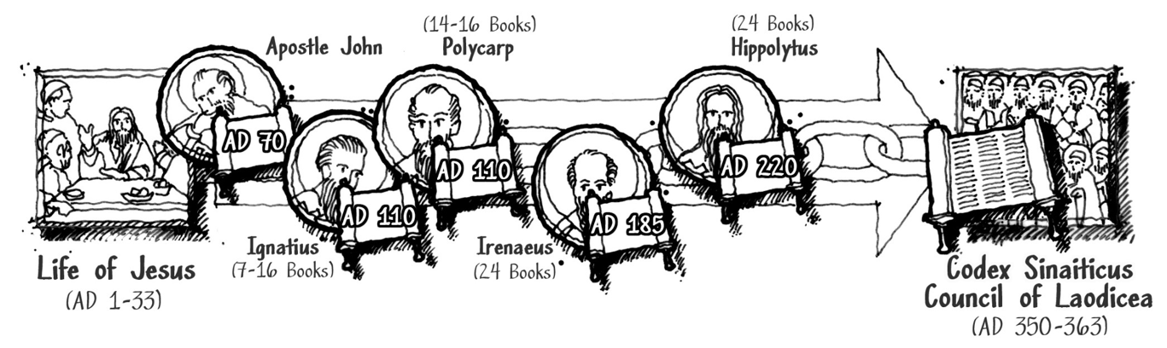
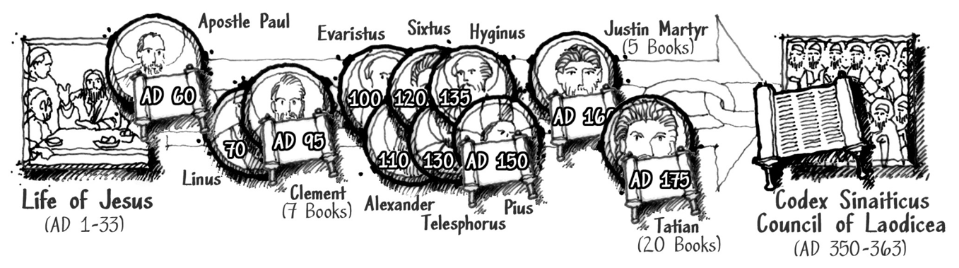
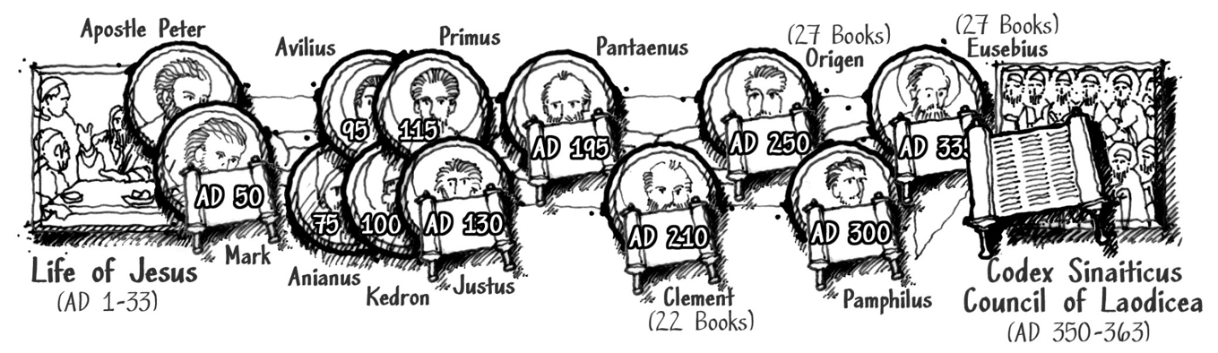
70 AD
185 AD
110 AD
220 AD
John’s Gospel
(prior to Temple Destruction)
60 AD
100 AD
95 AD
175 AD
Paul’s Letters
50 AD
195 AD
75 AD
250 AD
Mark’s Gospel

Slide 21

All lies are driven by one of three possible motives … Greed, Sex, Power

Slide 22
⁶ Then Peter said, “Silver or gold I do not have, but what I do have I give you. In the name of Jesus Christ of Nazareth, walk.”
Acts 3:6
⁵ Listen, my dear brothers and sisters: Has not God chosen those who are poor in the eyes of the world to be rich in faith and to inherit the kingdom he promised those who love him?
James 2:5
Greed?

Slide 23
Clement of Alexandria (200 AD) Said This About Paul:
“The only reason why he did not take her about with him was that it would have been an inconvenience for his ministry.… [The apostles], in accordance with their particular ministry, devoted themselves to preaching without any distraction, and took their wives with them not as women with whom they had marriage relations, but as sisters, that they might be their fellow-ministers in dealing with housewives.”
Sex?

Slide 24
Ignatius (100 AD) Said This About the Apostles:
“For I pray that, being found worthy of God, I may be found at their feet in the kingdom, as at the feet of Abraham, and Isaac, and Jacob; as of Joseph, and Isaiah, and the rest of the prophets; as of Peter, and Paul, and the rest of the apostles, that were married men. For they entered into these marriages not for the sake of appetite, but out of regard for the propagation of mankind.”
Sex?

Slide 25
Tacitus Said This About Followers of Christ:
“Consequently, to get rid of the report, Nero fastened the guilt and inflicted the most exquisite tortures on a class hated for their abominations, called Christians by the populace. Christus, from whom the name had its origin, suffered the extreme penalty during the reign of Tiberius at the hands of one of our procurators, Pontius Pilatus, and a most mischievous superstition, thus checked for the moment, again broke out not only in Judaea, the first source of the evil, but even in Rome, where all things hideous and shameful from every part of the world find their centre and become popular. Accordingly, an arrest was first made of all who pleaded guilty; then, upon their information, an immense multitude was convicted, not so much of the crime of firing the city, as of hatred against mankind. Mockery of every sort was added to their deaths. Covered with the skins of beasts, they were torn by dogs and perished, or were nailed to crosses, or were doomed to the flames and burnt, to serve as a nightly illumination, when daylight had expired.”
Power?

Slide 26
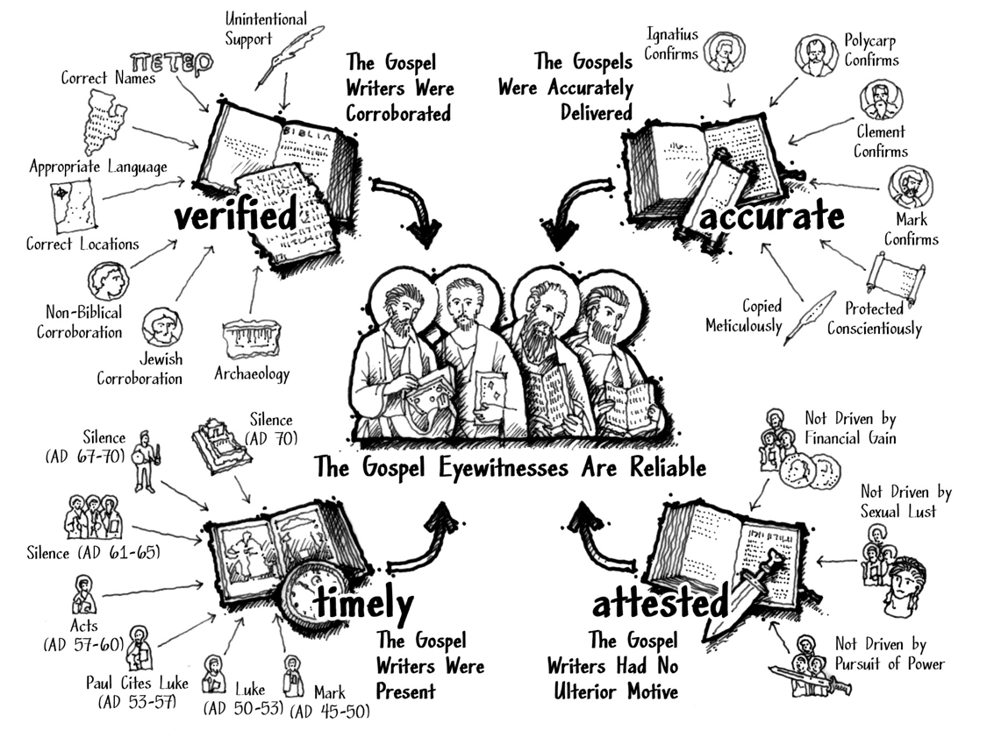




The four eye witness tests Prove the Gospel’s Veracity

